Slide 1
What is a Thinking Classroom?
Robert Weston
2024 BEdA Biennial Conference Kennewick, Washington
July 24th 2024

Slide 2
Overview
At the end of this session participants will:
Thinking Question(s)
What was the research?
What are the 14 essential practices?
Go into detail on four.
Questions?
have experienced a thinking classroom, including the setup, facilitation, and question types.
know at least one of the fourteen essential practices and identify one way to implement it in their educational setting.

Slide 3
Thinking Question(s)
Task 1: Find positive numbers whose sum is 25 and whose product is as large as possible.
Task 2: How much money will you need to retire?
Task 3: Four 4’s

Slide 4
Thinking Question(s)
Reflect
What was I doing?
What questions was I asking?
How did you feel?
How do you think students might feel answering this question?

Slide 5
II. What was the research?
Over 15 years, Peter Liljedahl;
worked with 400 K-12 teachers
worked in teams of 8-12 in 2 week cycles
focused on increasing student thinking by changing;
whether furniture was in the classroom
how teachers responded to questions
where students worked
what students wrote on
how students completed homework
how grades were awarded
many, many other factors

Slide 6
What was the focus?
Peter looked for optimal practice for thinking, meaning practices;
worked for different teachers
increased thinking in different students
worked for six to eight weeks for a new group of students

Slide 7
III. What are the 14 essential practices?
1. What types of tasks we use
2. How we form collaborative groups
3. Where students work
4. How we arrange the furniture
5. How we answer questions
6. When, where, and how tasks are given
7. What homework looks like
8. How we foster student autonomy
9. How we use hints and extensions
10. How we consolidate a lesson
11. How students take notes
12. What we choose to evaluate
13. How we use formative assessment
14. How we grade

Slide 8
1. What types of tasks we use
As-Is Curricular Tasks
Non-Curricular Tasks
Scripted Curricular Tasks

Slide 9
As-is Curricular Tasks
Ex.
“If log_2(8) =x can be rewritten as 2^x = 8, then x = 3 since 2^3 = 8.
Find log_2(16).”

Slide 10
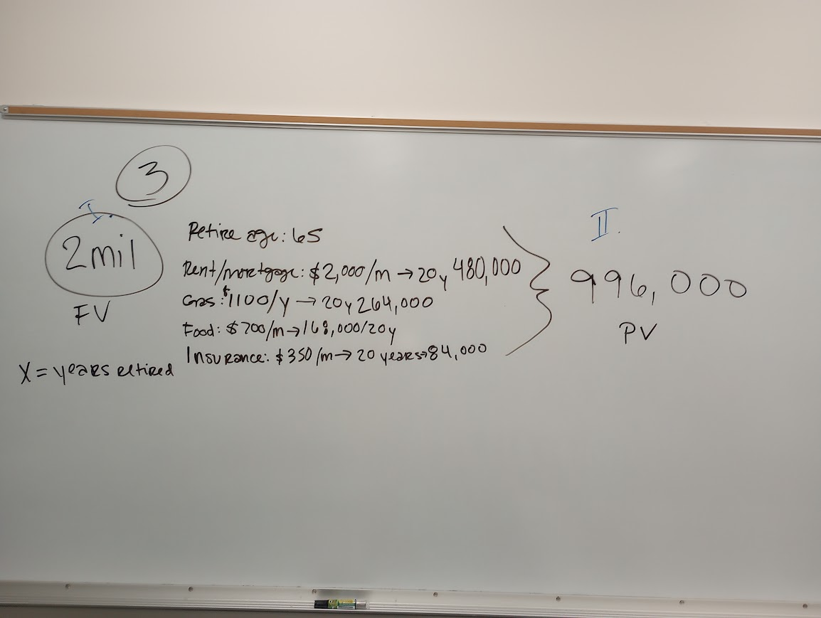
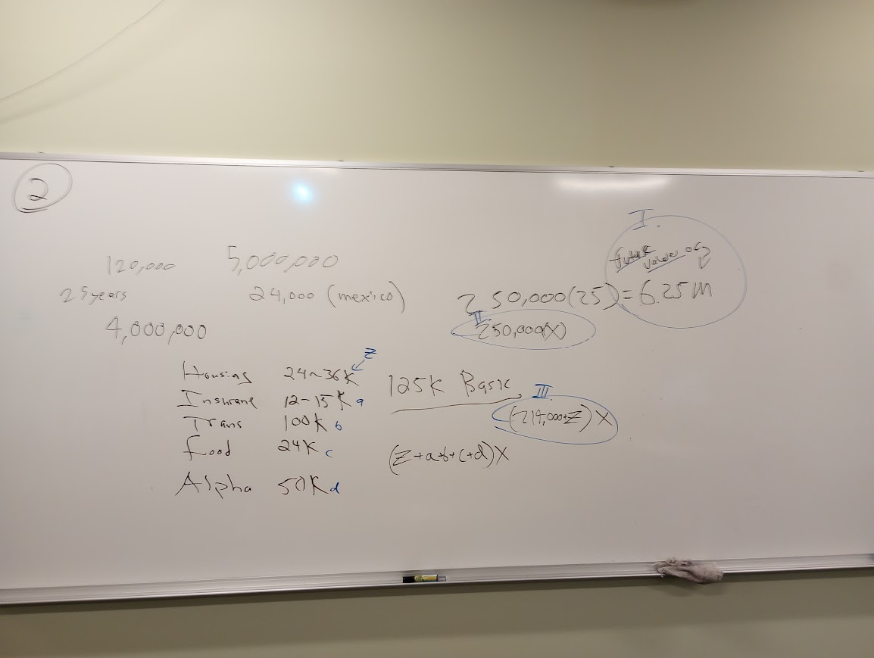
Non-Curricular Tasks
From Building Thinking Classrooms, pg. 69
“Decompose 25 using addition. For example;
25 = 10 + 15 25 = 10 + 10 + 5
What is the biggest product you can make if you multiply the addends together?”
One of mine:
“How much money will you need to retire?”

Slide 11
Scripted Curricular Tasks
From Building Thinking Classrooms, pg. 27
“How would I expand (x + 2)(x + 3)? x^2 + 5x + 6
What if the result was x^2 + 7x + 6?”
One of mine:
“ If 8=2^x what is the value of log_2(8)?”

Slide 12
Scripted Curricular Tasks - BTC Professional Learning Community
AY 2023-2024
Learning Outcome: Solving rational equations of the form (1/a)/(1/b) = #.
Questions
Solve for y; 1/y = ½
Solve for y; 1/y = 5
Solve for y; 1/(y + 1) = ½
Solve for y; 1/(y + 1) = 5
Solve for y; (y)/(y + 1) = 5
6. Solve for y; (1/y)/(y + 1) = 5 7. Solve for y; (1/y)/(4) = 5 8.Solve for y; (1/y)/(1/4) = 5 9.Solve for y; (1/y^2)/(1/4) = 5 10. Solve for x; (1/y^2)/(1/y) = 5

Slide 13
Scripted Curricular Tasks - BTC Professional Learning Community
AY 2024-2025
Next year the focus is on;
Curriculum-aligned questions
Thinking questions
Assessments

Slide 14
If we have time, let’s write our own!
Learning Outcome:
Questions

Slide 15
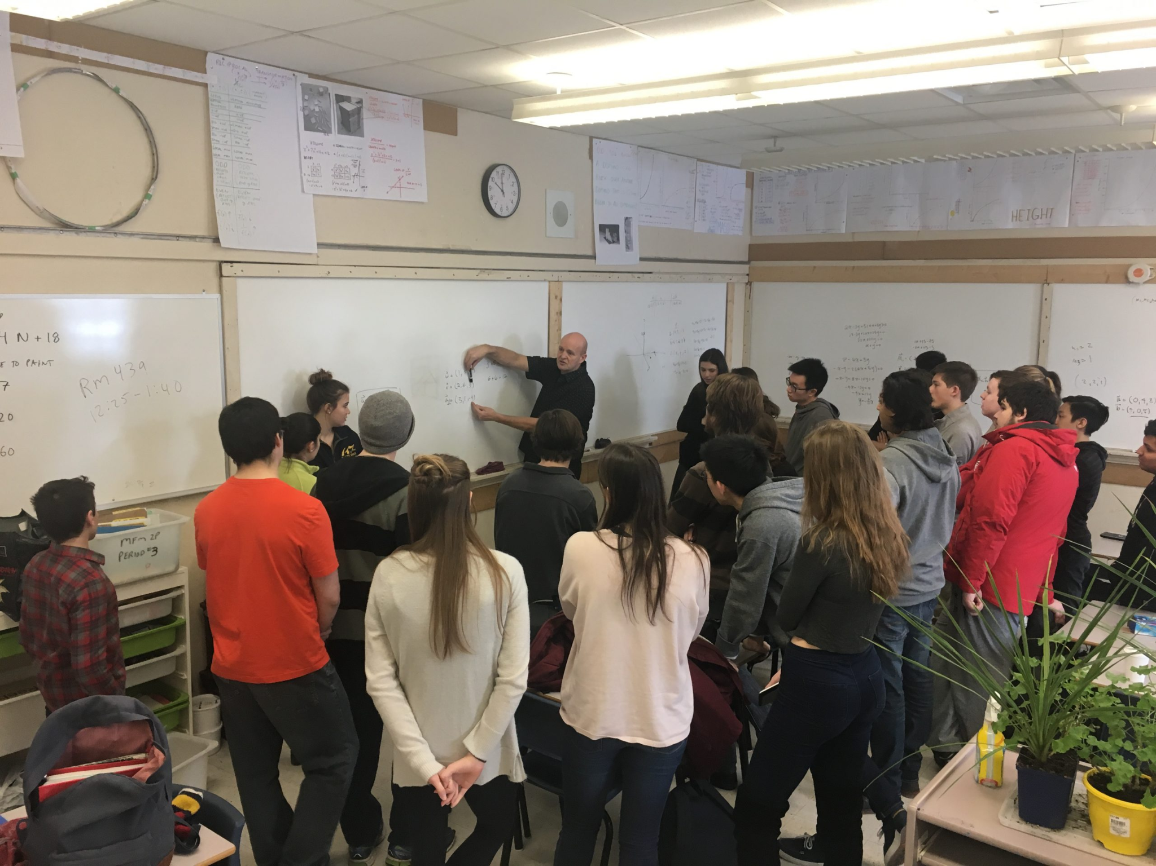
4. How we arrange the furniture

Slide 16
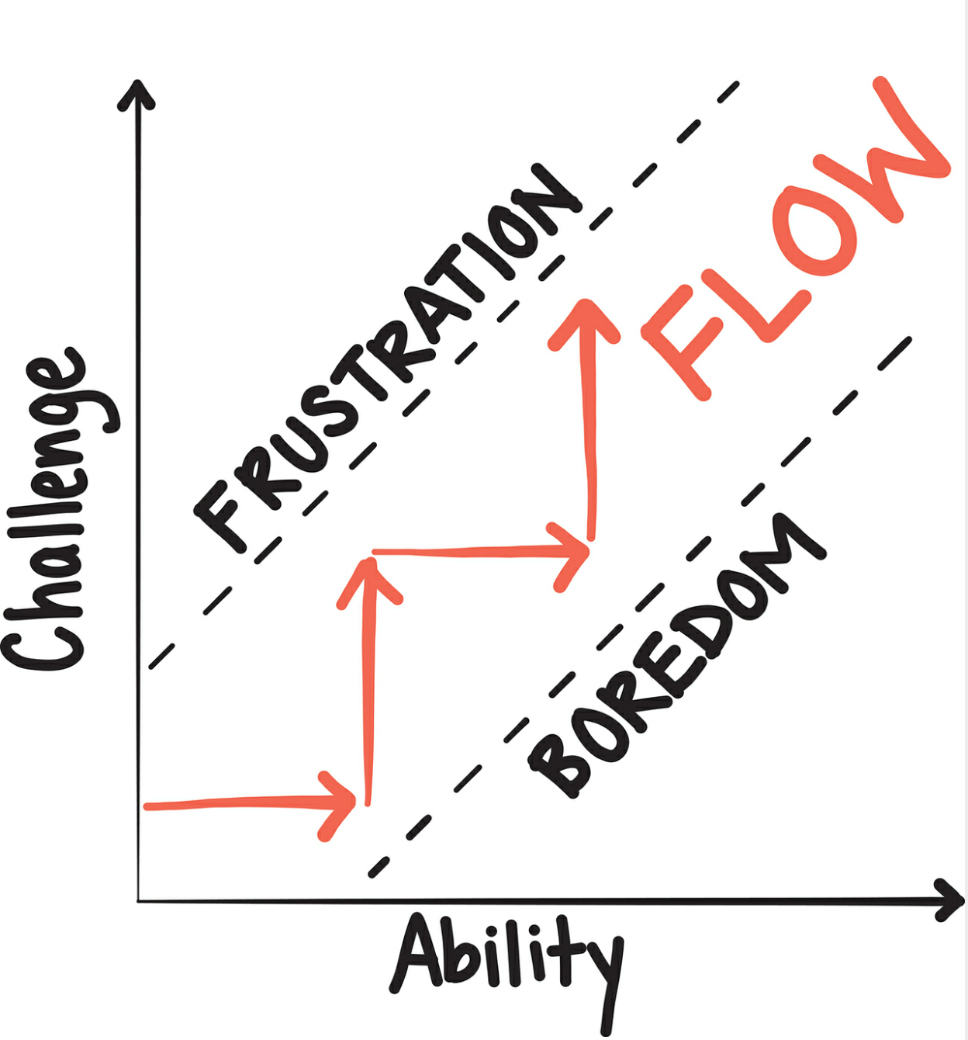
9. How we use hints and extensions

Slide 17
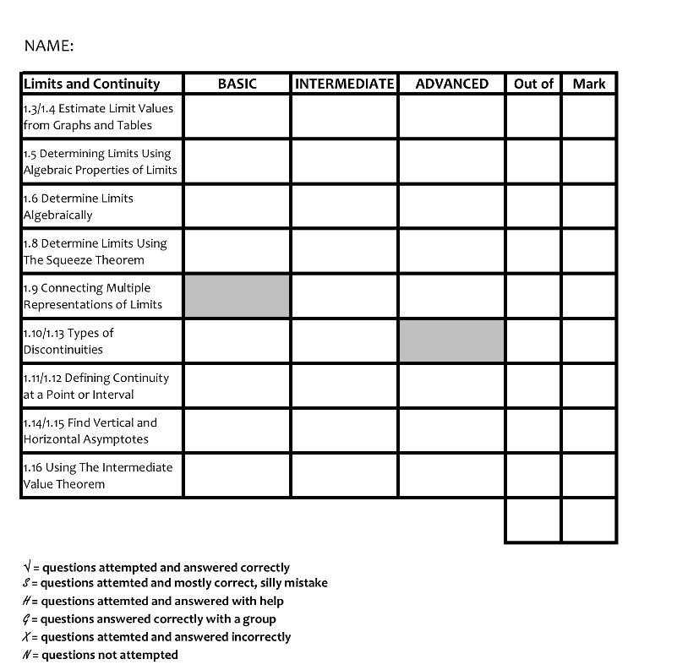
14. How we grade
Image: https://lsquared76.wordpress.com/2022/08/01/grading-in-thinking-classroom-blaugust-post-1/

Slide 18
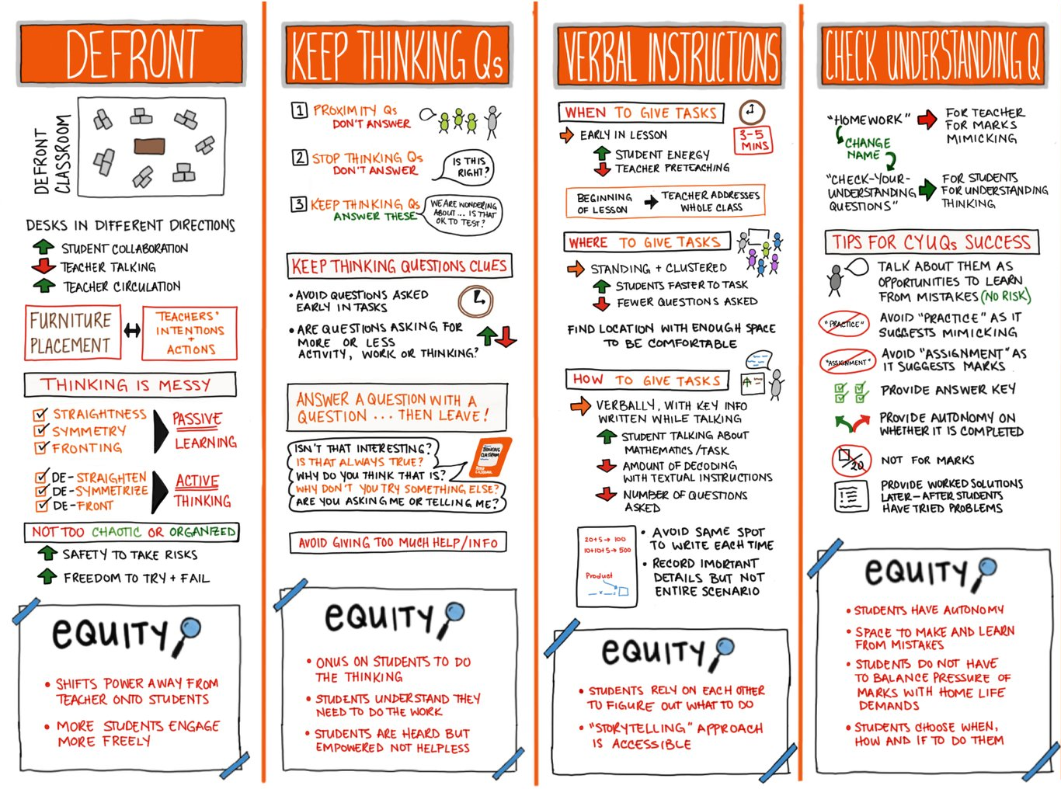
Additional Resources
Liljedahl, P. (2021). Building Thinking Classrooms. Corwin
Liljedahl, P. (2020). Building Thinking Classroms. https://buildingthinkingclassrooms.com/
Book Study Guide
Executive Summary
Laura Wheeler, a teacher at Ridgemont High School in Ottawa Canada has created a number of great illustrations

Slide 19
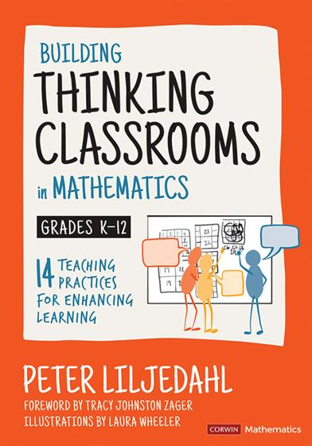
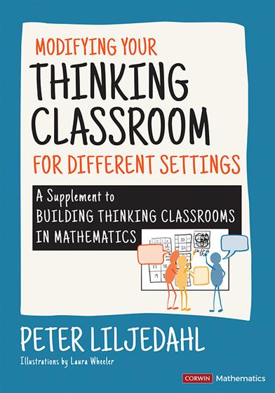
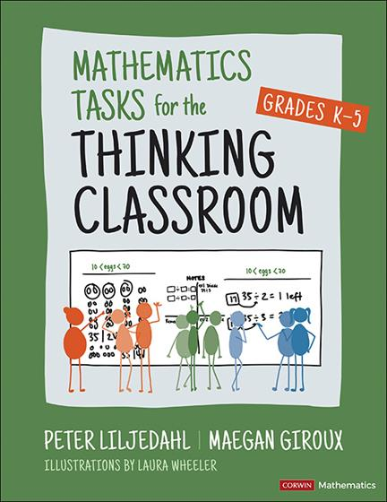
How can I learn more?

Slide 20
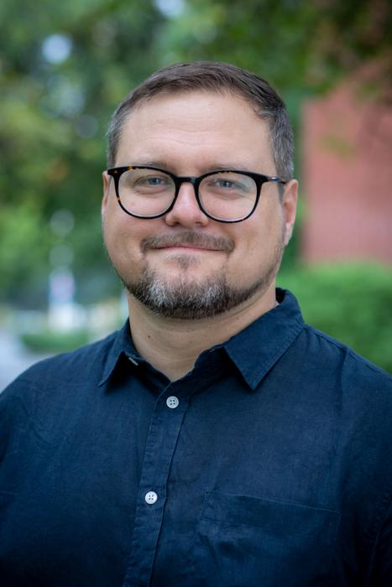
IV. Questions?
Thank you to Peter Liljedahl, Dawn Draus, Katelynn Orellana, Marcus Antonio Gunn, and the team at BEdA SBCTC.
Session Slides
Questions, comments, concerns; robert.weston.82@gmail.com

Slide 21
References
Liljedahl, P. (2020). Building thinking classrooms in mathematics, grades K-12: 14 Teaching Practices for Enhancing Learning. Corwin Mathematics.
Wasserman, N. (2014). A rationale for irrationals: An unintended exploration of e. Mathematics Teacher, 107(7), pp. 500-507.

