Slide 1
Adult Education is
Social and Economic Justice
MarcusAntonio Gunn, ABD
Policy Associate, Basic Education for Adults
EDI & Barrier Mitigation
Washington State for Community and Technical Colleges
Notes:
I am MarcusAntonio Gunn and I have the pleasure of serving at the State Board for Community and Technical colleges as the Policy Associate for Equity, Diversity, Inclusiveness and Barrier Mitigation. Thank you for joining me on today to talk about the value proposition of Basic Education for Adults programs as insitutions/organizations of social justice.

Slide 2
Today we will
Take stock of our own agency in promoting justice.
Engage in Re-Education by arranging a timeline of Adult Education and White Supremacy Culture in America.
Highlight how and why Adult Education is a form of Social and Economic Justice.
Commit to creating collaborative partnerships that integrate our programs across our system, colleges and departments.

Slide 3
SPOILER ALERT
*****SPOILER ALERT*****
It’s gonna get awkward
We have all done some of the things we notice as harm
None of us have all of the answers
There is no one *right* way
This is a lifelong process
Notes:
No right way, part of the work is in figuring it out. Wrestling with it. Struggling through it.

Slide 4
Center BIPOC Folx
To address our needs as people of color, we aim to cultivate a space that:
Is away from the gaze of Whiteness (breakout rooms)
Rejects the centering of Whiteness
Dignifies our unique struggle with racism
Honors, utilizes many ways of learning, knowing and doing
Cultivates joy, love and community
Notes:
BIPOC folks and marginalized groups have been quieted for a long time such as in voter suppression, health disparities and wage gaps (among other things). They have been valued less by the nation and society at large. We center BIPOC folks as a tiny step towards reconciliation. We acknowledge and celebrate the contributions of BIPOC folks and bring their voices to the center out of necessity.
There is a difference between whiteness as a construct and cultural framework, versus white people. Our training will dig more deeply into this over the next couple of hours.
For colleagues of color who may need to step away for the moment, Room B has been designated as a Black, First Peoples, and Colleagues of Color space. For collegues of color, we designated Room F as a designated quiet space to reflect, take a breather, re-center.

Slide 5


An invitation to engage in this practice.
Window
(looking out)
How I see my context – people, situations, structures, society…
Mirror
(looking in)
How I see myself – my
beliefs, identity, experiences, strengths, fears...
Notes:
We will be doing more Mirror work throughout this training than Window work. Find moments to journal, doodle, reflect on themes, content and concepts shared throughout our time today. This training isn’t going to solve the ills of society today. Martin Luther King talked about bending the arc of the moral universe towards justice. The bending of that arc does not happen automatically. It is constant work. Constrant reflection. Advancing equity is a 24/7 task as its the hope for a society that accepts, respects and aims towards true humanity, care and dignity.
Reflexivity is an important practice as equity leaders. We will spend a lot of time in the mirror today to refocus on lens.
And real quick, let’s define “lens” in the equity sense in education. When we say lens we mean – how we are socialized and the ways it impacts us as individuals and how we individually wield this privilege of education and educating.
Think about this: How does how you were raised, your identity, impact/shape how you see the world and the systems in society at work.

Slide 6
Mirror, Mirror
Structural Racism and Implicit Bias in American Society and Higher Education
Notes:
Equity work is constant reflection. To continue to bend the arc of the moral universe towards justice, we must begin by making an inventory of our own social identities in relationship to oppression. We get systematic training in "how to be" each of our social identities throughout our lives. In this portion of the session, we will look inward, doing the mirror work as we reflect on our practices being influenced by how we have been socialized. We will then discuss how we, as agents of our industries and agencies, are responsible for institutional socialization. Through the AEAC, we have the privilege and power to assist adult learners in BEdA programs to achieve academic success and social and economic justice.

Slide 7
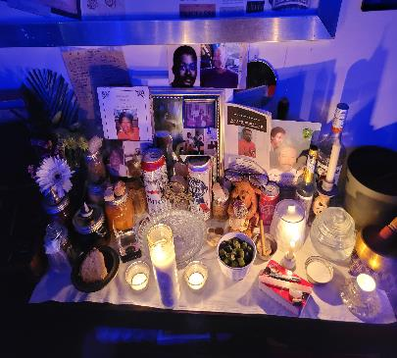

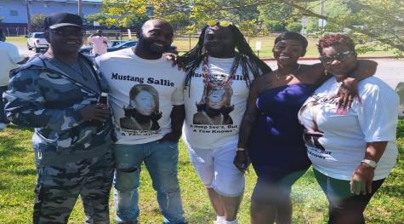

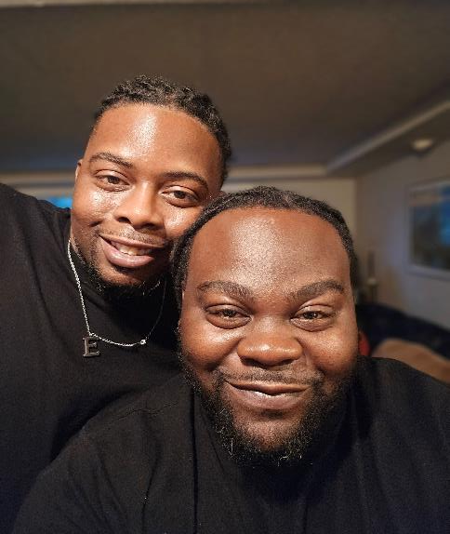
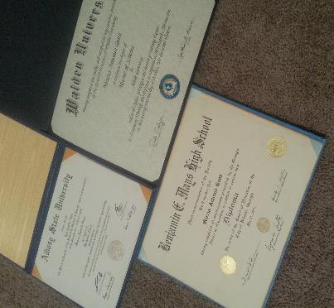

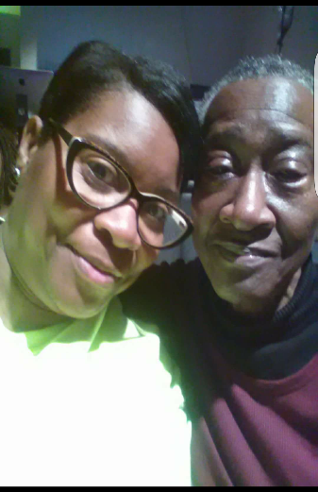
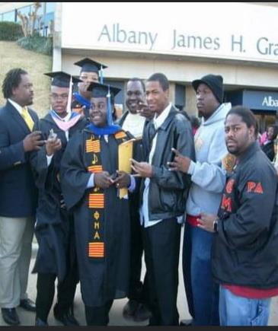


MarcusAntonio’s Introduction
I am the grandson of cotton and rice fields
Red clay and ocean water
Blackfoot Indian and Geechee
The son of Carpenters
The product of
Brown v. BOE, Civil Rights and Stonewall
I am my ancestors wildest dreams
I am who I have been waiting for…
Notes:
I first pay homage to my ancestors, the Gunns, Wares, Brooks, Hendrix and all those whose names i do not know but whose blood has lasted through generations.
My family would tell you, I was always studious. In grade school i walked around with a pocket protector complete with glasses and pens. What I know about being Black in this country came from parental, environmental, social religious, and political influence. I have been an advocate for Blacks bodies since before my teens and an advocate for people of color within the LGBTQIA+ community since 16. I did my first canvas regarding Black and brown issues at 7.
I am the first male in my family to graduate with a high school diploma on both sides and a first generation college student. I am currently writing my dissertation to obtain my Ed.D in Higher Education Administration -Adult Education. But I should not have been the first in my family to attend college or the first male to graduate from high school.
My grandmother should have been the first person in my family to my knowledge to attend college. She wanted to be a nurse but was denied entry into a program so she went for her NA certificate and worked her way up to being a cardiatric nurse until her retirement. My first time seeing a bust of a Black person was my grandmother at Crawford long hospital. My mother should have been another trailblazer before me. She had my bother 6 months before her senior graduation and went back for her GED. She wasn’t provided an option to complete HS. It would be a little before decade after finishing HS that she was granted the HSD. A young divorcee, there were workforce options that could have been afforded to my mother, but due to lack of knowledge or a navigator, we missed opportunities for her education and our survival.
I went into Adult Education because of my personal relationship with education. While my brother has since received his HSD about 4-5 year ago, he would have been an 02 graduate, there was a point where my father, sister and brother lacked the HSD or GED credential. It was there struggles that I saw in other families when I started my career in education and is what drew me to Adult Ed. We are so lucky in WA to have certain legislation and mechanisms in place for Adult Learners. The opportunity and potential we have isn’t afforded to states like Arkansa, South Carolina, my home state of Georgia, Texas, FL and so many others.
I am so excited about the future as my niece Makayla and my nephew Mycah will be graduating high school two decades after my completion and both will be attending college. This is a big deal for my family. Mycah is taking a route with WIOA funds at a Technical College, in Atlanta, while Makayla is headed to my alma mater, Albany State University, in Albany, GA. From their lips and other family members and a host of friends, representation indeed matter. I am fortunate that when people think about their educational journey they think of my service and passion to help all. I have built my career around educating Black and Brown communities of the opportunities afforded to them for workforce skills and academic training because of the lack of attention to communities that look like mine. I do not profess to be a DEI expert, but this work has been the foundation of my professional and personal work.
Lastly, the one who sustains me, wipes my tears, my biggest cheerleader and love of my life is the gentleman pictured with me in the center, Sharvoski. My husband is also a first generation college student who completed his studies through our CTC and used the transfer option to attend and graduate from UW. He is currently in his 2nd career with DSHS, I mention his 2nd career because education has allowed my husband to elevate beyond his wildest expectation. As you will hear stated through our times together providing connections and access to education for people of color isn’t just my career, it’s a personal conviction of being an Educated Educator.

Slide 8
Introductions
What are you hoping to experience or learn in this community?
What gifts do you bring to this space? What wisdom have you gotten from reading, mentors?
When do you need support? When do you ask for support?
Notes:
2mins Explain constructivist listening activity for participants
10mins for Breakouts- Triad 3mins each
Support group: 3 participants; each talker responds to a prompt with equal time given.
https://www.nationalequityproject.org/frameworks/constructivist-listening

Slide 9
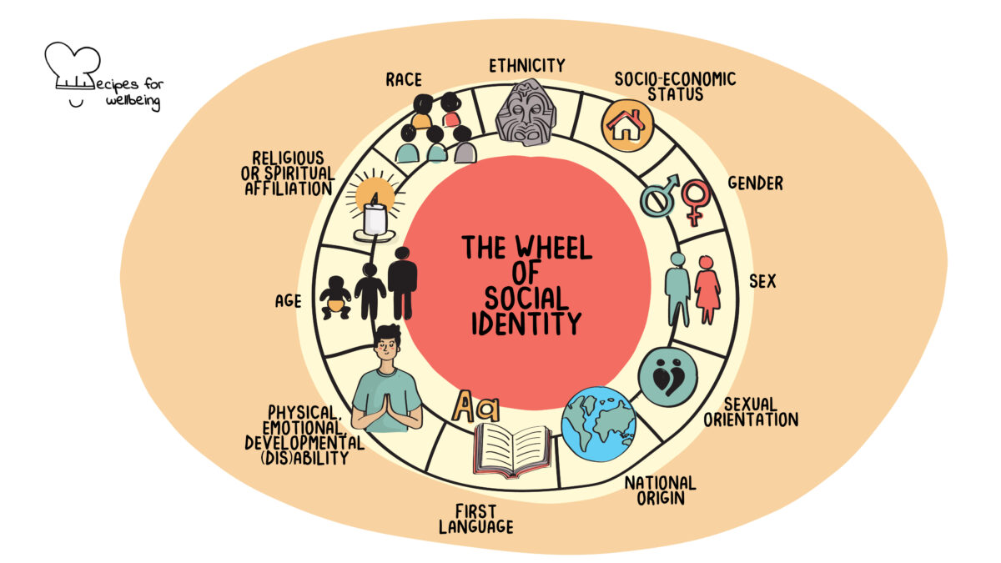
Wheel of Social Identity
© Recipes for Wellbeing
Notes:
Reflection Activity- 10mins
Choose one of the social identities and write down at least 10 examples of what you’ve leaned about being that identity.

Slide 10
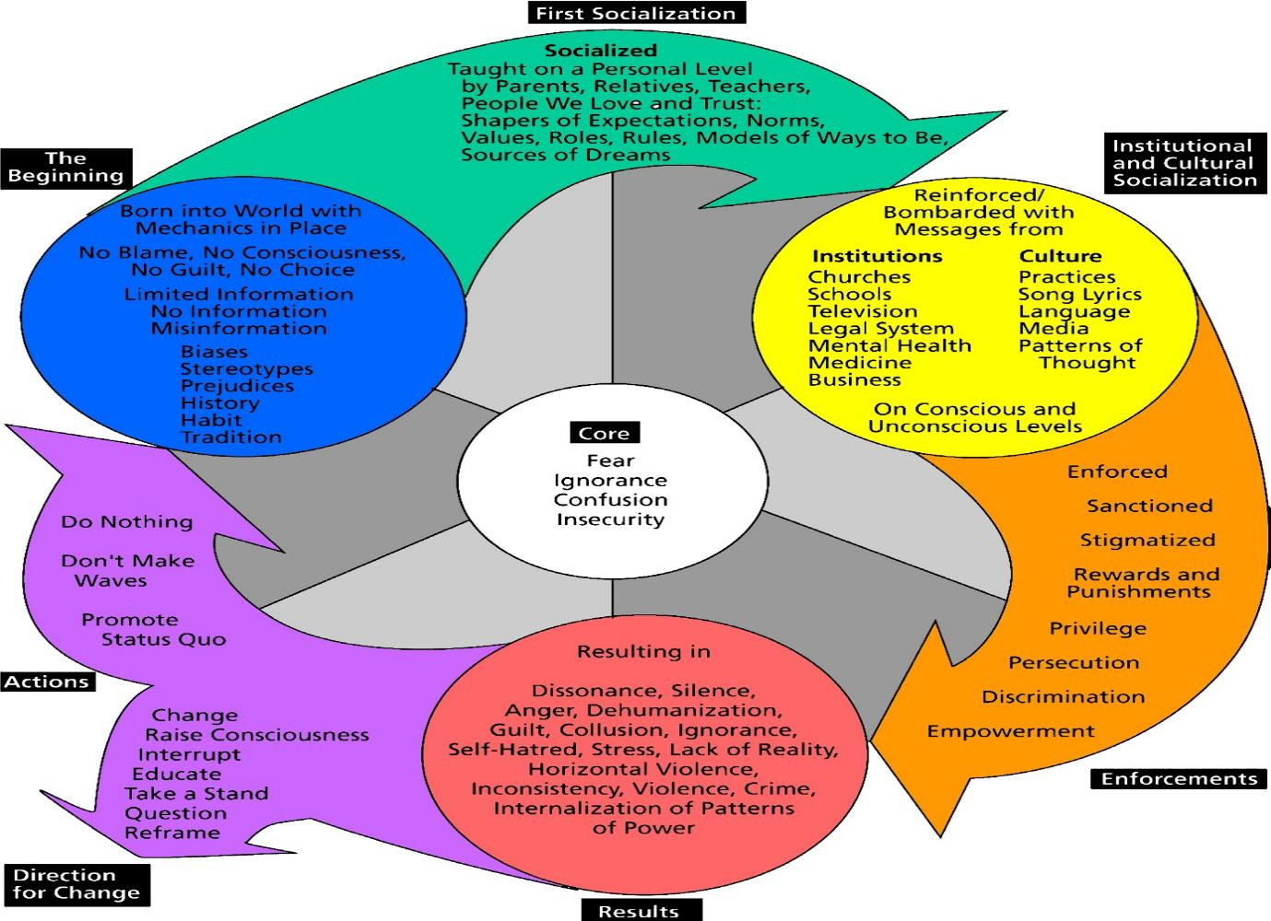
Cycles of Socialization
Harro, B (2013) The cycle of socialization, in Adams et al. (eds.) Readings for diversity and social justice, 45-52.
Notes:
7mins
The cycle of socialization created by Harro represents how the socialization process happens, from what source it comes, how it affects our lives, and how it perpetuates itself.
Beginning/First Socialization
Our socialization begins before we are born, with no choice on our part. We are each born into a specific set of social identities related to gender, ethnicity, skin color, first language, age, ability, status, religion, sexual orientation, and economic class, and these social identities predispose us to unequal roles in the dynamic system of oppression.
In some ways, I envy children. They are fearless. They often reveal who we are as individuals and communities through their inquiries. Our ways of thinking and being that influence children's socialization in society. Just as our parents and role models socialized us. OUR FAMILY MAKEUP and ENVIRONMENTS continue to shape how we work, serve, and show up in the world.
Because we enter this world with all the mechanisms, assumptions, and structures already in place, we shouldn't feel guilty or responsible for the world we are born into. Yet, as actualized adults, we can't shy away from the systemic structural ways privileges hurt others.
With this in mind, though, there are groups of people who are targeted, disenfranchised, exploited, and victimized by prejudice, discrimination, and other structural obstacles. These targeted groups include women; racially oppressed groups, women within racially oppressed groups; the LGBTQIA+ Community; those who are in ways disabled, those neuroatypical; those incarcerated; Jews; elders; youth; and people living in poverty.
Institutional Socialization
Once we begin to attend school, go to a place of worship, visit a medical facility, play on a sports team, work with a social worker, seek services or products from a business, or learn about laws and the legal system, our socialization sources are rapidly multiplied based on how many institutions with which we have contact. Most of the messages we receive about how to be, whom to "look up to" and "look down on," what rules to follow, what roles to play, what assumptions to make, what to believe, and what to think will probably reinforce or contradict what we have learned at home.
If we are members of the groups that benefit from the rules, we may not notice that they aren't fair. However, if we are members of the groups penalized by the rules, roles, and assumptions, we are part of a larger structure than just our families. We get consistently similar messages from religion, the family doctor, the social worker, the local store, or the police office, so it is hard not to believe what we are learning.
We are inundated with unquestioned and stereotypical messages shaping how we think and believe about ourselves and others. What makes this "brainwashing" even more insidious is that it is woven into every structural thread of the fabric of our American culture.
It might seem logical to ask, "why people don't just begin to think independently"? If they don't like what they see around them. Why don't we ignore these messages if we are uncomfortable with them or if they are hurting us? Largely, we pay attention to the messages, rules, roles, structures, and assumptions because enforcements are in place to maintain them. And those like myself in equity work who question conventional societal messaging are labeled as troublemakers or, even worse, the cause of the problem. One example is the question, "Why is everything about race?" The simple answer is that the social construction of race has played a major part in every law, policy, and procedure ever created.
Results
We, as system leaders, are well aware of the results.
I want to spend more time on Directions for Change as this gears us up for liberation and justice. We can not create transformational change alone or without radical imagination and action. As members of this body, you have a cause, responsibility, and power to create change. To wield your powers for good and for the success of our adult learners, we must reframe our understanding and shift towards critical consciousness of our thoughts, actions, and deeds.

Slide 11
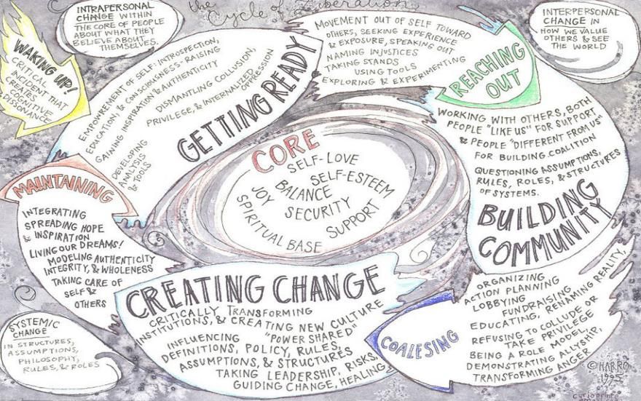
Cycles of Liberation
Harro, B (2013) The cycle of liberation, in Adams et al. (eds.) Readings for diversity and social justice, 618-624.
Notes:
7mins
Harro believed as we are socialized and therefore perpetuate the concepts of biasness, there must be a process that, when maintained, lends to liberation from at least explicit bias diminishing implicit bias altogether. It is important to note for this cycle, one could enter at any point, but most often, it does begin with waking up.
Waking Up
Harro states that being awakened can begin with an intrapersonal change through either a critical incident or incremental challenges of our worldview. This causes cognitive dissonance, disrupting ways of thinking and being as we knew them; at this stage, what made sense, now ceases to make sense.
Getting Ready
When we know something, we can't unknow it. For example, once you understand the effects of chattel slavery on the generations of the enslaved, poverty is easy to understand. Likewise, once you understand the role of slave patrols, you understand the disproportionate number of incarcerated black and brown folks. Getting ready means educating one's self by intentionally focusing on conscious raising. Here, at this stage, we take the steps needed to empower ourselves by dismantling our ways of thinking and doing, checking both our discrimination and privileged attitudes that hamper or hinder the existence of others.
Reaching Out
We reach out to find common ground and shared beliefs. Here we may get labeled the troublemaker, the boat rocker. We may be pressured by our own communities to stop our efforts. But, here, we use our newfound tools with others and begin to express our newfound ways of thinking and doing.
Building Community
Here, as the AEAC, you have your own community; though designed, everyone here desires to see all of our adult learners succeed, understanding that through our power, there is more to be done to uplift our most vulnerable and justice-impacted adult learners. Here in this stage, dialogue is most important. These dialogues, especially when race is centered, will be uncomfortable; sit in it. Stew in it. When done well, these dialogues lead to deeper and richer meaning, potentially creating lasting systemic change.
Coalescing/ Creating Change
Your power as the AEAC council could interrupt the oppressive and inequitable system we function in within higher education in Washington. As a coalition, you all have power. As a community of agitators, you can refuse to play your designed role, collude in oppression, and accept the status quo. Instead, you can think radically about the future of adult education. With this group, you have the ability to move hope with shared power, trust, and optimism. You can make a true difference by working together and organizing through your various industries or agencies and roles. There's power in numbers and cohesion, and the possibility of logical outcomes is more likely than unattainable goals.
Maintaining
The work we do has brought us here today. Maintaining our workplan and working on our tasks helps strengthen our cause. We must remain committed to our student's success for the betterment of their future and our own. As a diverse body, we must continuously be committed to learning from and understanding one another to create transformative change.
Core
At the core of this illustration are qualities that help hold our work together. Liberation is the practice of love, finding balance, development of competence, the belief that we call can succeed, joy, the knowledge that we are not alone in this fight towards an equitable and justice system, a commitment to transformation, change, and radical honesty, passion, and compassion. Liberation is about something far greater than the individual; it's about the force that connects us all as living being to create a better world of our purposeful and intent-filled design.

Slide 12

AND……. BREATH
Notes:
5mins

Slide 13
Starting with Re-Education;
Situating History
  Timeline of Higher Education/ Adult Education
  Timeline of White Supremacy Culture
Notes:
Before the first instution of learning was ever constructed in the U.S. of America, white supremacy culture existed.
In a moment we will develop a timeline of the development of white supremacy.
But before I start, when I say white supremacy let’s not get this confused with white supremacist. I'm not speaking KKK, Aryan Nationalist or Atomwaffen. This extreme version, while representative of white supremacy culture, also erases the everyday white supremacy that is threaded throughout our society. In fact, it often only spotlights the male involvement in these acts. White women have been long absent from conversations related to white supremacy even though their presence has been evident throughout time.
When I say white supremacy, I am speaking to the idea that elevates whiteness as the default or assumed, the culture of White Supremacy.

Slide 14
SBCTC Vision
Leading with racial equity, our colleges maximize student potential and transform lives within a culture of belonging that advances racial, social, and economic justice in service to our diverse communities.
Notes:
30 Seconds
I believe through our work in BEdA, SBCTC is a step closer to actualizing and advancing racial, social and economic justice through our vision. Specifically we focus on race and understand that it isn’t the only salient issue affecting society, but it is a consequential lens to view and assess other oppressive systems and therefore the more prominent. We understand that race is a social construct and non-monolithic concept. We hope for a future where the missing discourse on race is not there because it is not needed. We can’t talk education, housing, healthcare, politics without the inclusion of race as these topics will always fall short when assessing the needs of Blacks and other people of color in these United States, specifically. Education has been a tool of institutional advantage based on historic factors that have given this advantage to White Americans. In alignment with our vision BEdA promotes and knows that, “The objective of Adult Education is to adjust social injustice as well as to empower all disadvantaged adult learners.
I professionally believe that in order to lead with racial equity and transform lives within a culture of belonging, as Educated Educators we must understand the history of higher education’s part in the continued promotion of white supremacy culture. In my opinion this is the first step towards truly advancing racial, social and economic justice. Our CTC system, higher education as an industry, and American society is built off and thrives off white supremacy culture, that’s a fact.

Slide 15
Truth about Race
But race is the child of racism, not the father. And the process of naming “the people” has never been a matter of genealogy and physiognomy so much as one of hierarchy. Difference in hue and hair is old. But the belief in the pre-eminence of hue and hair, the notion that these factors can correctly organize a society and that they signify deeper attributes, which are indelible – this is the new idea at the heart of these new people who have been brought up hopelessly, tragically, deceitfully, to believe that they are white.
Ta-nehisi Coates. (2015). Between the World and Me.
Notes:
2mins

Slide 16
A Caste system
Like other old houses, America has an unseen skeleton, a caste system that is as central to its operation as are the studs and joists that we cannot see in the physical buildings we call home. Caste is the infrastructure of our divisions. It is the architecture of human hierarchy, the subconscious code of instructions for maintaining, in our case, a four-hundred-year-old social order…

Slide 17
Caste system cont.
Throughout human history, three caste systems have stood out. The tragically accelerated, chilling and officially vanquished caste system of Nazi Germany. The lingering, millennia-long caste system of India. And the shape-shifting, unspoken, race-based caste pyramid in the United States.
Each version relied on stigmatizing those deemed inferior to justify the dehumanization necessary to keep the lowest-ranked people at the bottom and to rationalize the protocols of enforcement.
Isabel Wilkerson. 2020. Caste: The origins of our discontents

Slide 18
History of using race as a concept to order society
“Americans believe in the reality of “race” as a defined, indubitable feature of the natural world. Racism – the need to ascribe bone-deep features to people and then humiliate, reduce, and destroy them – inevitably follows from this inalterable condition. In this way, racism is rendered as the innocent daughter of Mother Nature, and one is left to deplore the Middle Passage or the Trail of Tears the way one deplores an earthquake, a tornado, or any other phenomenon that can be cast as beyond the handiwork of men.
Ta-nehisi Coates. (2015). Between the World and Me.

Slide 19
Guiding ?? Timeline White Supremacy Culture
What are some historical and other factors that have aided in the continuing spread and strength of white supremacy?
Who and what have benefited the most from this continued strength and spread?
What actions would it take to really bring a decrease in and finally an end to white supremacy and by whom?
In what ways could we as practitioners act to decrease and eliminate white supremacy culture in colleges, universities and adult education programs?
Notes:
25min Activity
Using your phone, let’s map out a timeline of White Supremacy Culture by adding dates, important laws, and policies, death of prominent figures that have shaped the state of race relations in America. Please, use your device to search for these events.
Here are a couple of happens that aided the rise of White Supremacy Culture:
The concept of racism and ordering peoples based on features started as early as the 5th century with Aristotle and the Great Chain of being.
Bartolome de Las Casas wrote about the treatment of the Americas indigenous (Spanish), he advocated for the defense of the indigenous by recommending Africans for enslavement as an alternative. This was the 16th century.
In the 18th century we have Carl Linnaeus who is responsible for the taxonomy of species, he describe four variations of human species: White, Red, Yellow and Black. Carl was single handily responsible for scientific or biological racism.
Johann Blumenbach used cranial measurements to determine intelligence and racial make up. In his classification he used classifications that were subjective and unscienfic such as "hopeful" Europeans, "sad and rigid" Asiatics, "irascible" American natives, and "calm and lazy" Africans. This was the late 18th century.

Slide 20
AND……. BREATH
Notes:
5mins

Slide 21
Starting with Re-Education;
Situating AE History
  Timeline of Higher Education/ Adult Education
Cartwright, M. A. (1945). The History of Adult Education in the United States.
Dancy, Edwards, & Davis. (2018). Historically white universities and plantation politics: Anti-blackness and higher education in the black lives matter era
Ghimire, Koundinya, Chaudhary, Diaz& Hogge. (2023). A Model for Integrated Approach to Professional Development of Extension Educators: Implications of Adult Education Principles and Practices.
Notes:
Do you know when adult education began in what we know as America? Take a moment to pause and think?
As James Adams suggests, adult education began in America hundreds of years before the White man ever stepped foot in this nation. First, the Indigenous had to contend and learn about the same landscape and geography to live, cultivate and survive. Later, the next students would be the African Negro who had to learn through experience and punishment to survive, precariously and covertly, even to the disdain and confusion of their oppressor.
America's ideal of adult education was slow to be actualized. Yet several milestones point to adult education existence and steady persistence of growth into academic and programmatic services. A theme since the 1700s, the idea that adults need to learn a skill to survive and thrive, happens even today. Since the conception of what we know as America, adult education has always been centered on the ebbs and flow of societal needs.

Slide 22
Guiding Questions – timeline Higher Education
What are some historical and other factors that have aided in the continued operation of and growth of public higher education?
What are some historical and other factors that have aided in the continued spread of White Supremacy Culture in higher education?
Who and what have benefited the most from this continued strength and spread?
What are some of the equity issues within higher education?
Notes:
25 min Activity
Using your phone, let’s map out a timeline of Higher Education in America. I will give you all dates and occurrences that specifically align with Adult Education. For now, let’s open the timeline by adding other dates, important laws, and policies that have shaped the state of education. Please, use your devices to search for these events.

Slide 23
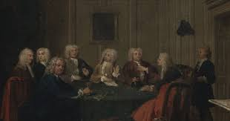
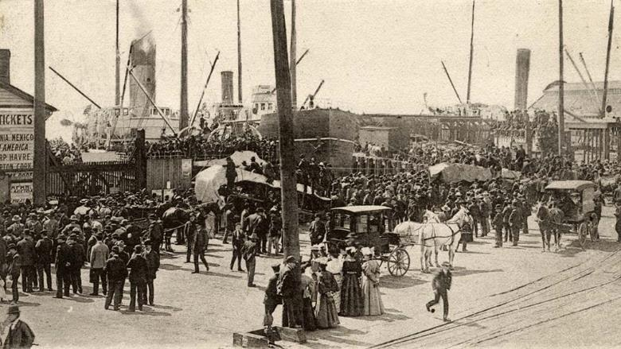
Images of Junto Clubs and Industrial Revolution waterfront
Industrial Revolution-1760s Seattle Central Water Front
Junto Clubs-1700s
Notes:
10:38 AM
Adult education programming could be stated to have been started by Benjamin Franklin, who established Junto clubs (the 1700s) to discuss scientific and other subjects.
The most documented account of adult education skills training can be found during the industrial revolution. As new technology was introduced, there was a need to learn and master machinery. Here we have our introduction to agricultural and mechanical institutes. We still see the need for industry training throughout today; our state boasts over 100 programs throughout our 34 CTC system.

Slide 24
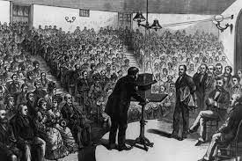
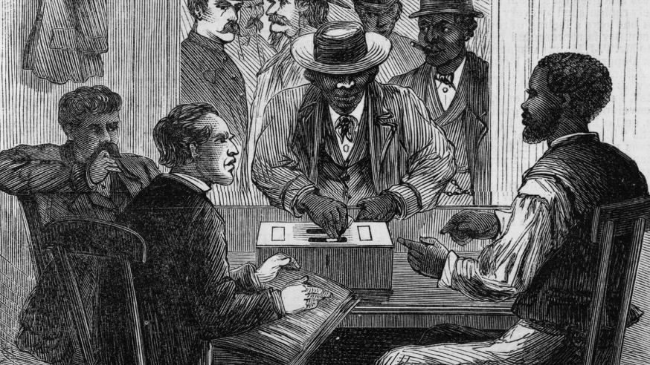
Images of Lyceum Halls and Reconstruction
Reconstruction- 1860’s
Lyceum Halls-1830
Notes:
Lyceums or public lectures became of great importance in the 1830s. This platform centered on free discussion almost like the Junto clubs of the 1700s. At one point, over 3000 Lyceums spread throughout the united states of America, even in the South. These were known as the 1st soap boxes. However, in late 1840-50, we see a decline in these lyceums as topics of race were introduced. The admission to the Union of slave states and the looming fright of and division of succession was the demise of the free topic platforms that Lyceums were known for.
In times of war and uncertainty, and at this day in time we are most definitely in a time of uncertainty, adult education programming declines and becomes the first to lose advocacy and funding, such as during the civil war and the Reconstruction period. During this time, services and training were pulled back even further as the American Negro sought opportunities to develop, learn and master new skill sets that they were once cut off from.

Slide 25
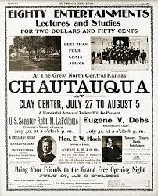
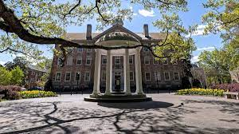
Images of Chapel Hill Public State College and Newspaper
UNC Chapel Hill-
1st Public State College
Notes:
In 1874 we saw the introduction of museums and libraries, which aided free and public learning. The Chautauqua Institute in New York was and still is one of the leading adult education ventures in America. Today, the Chautauqua Institute is still “dedicated to the exploration of the best in human values and the enrichment of life through a program that explores the important religious, social, and political issues of our times. The institute is known to stimulate provocative, thoughtful involvement of individuals and families in creative response to issues; and promotes excellence and creativity in the appreciation, performance, and teaching of the arts.

Slide 26
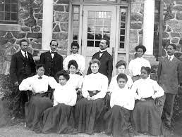
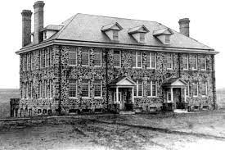
Images of Cheyney University of Pennsylvania
Cheyney University of Pennsylvania
Notes:
In 1886 the Philadelphia Extension Society was founded in America. Based on university systems already established in the UK. Though universities started as lecture halls, there was a need to extend beyond lectures and correspondence work; America saw a need to extend to extramural classes, special institutes, and short courses. While larger institutions were affixed to providing collegiate level courses, many smaller and extramural sites also offered the first secondary courses (7-12th grade) for the lower level learners.
Because Blacks/African Americans were not allowed to learn with or amongst Whites and were most often extended inadequate facilities and training, there became a need for Negro Universities, today known as Historically Black Colleges and Universities.
Before Works Progress Administration Educational programs, which provided jobs training, ESL courses, citizenship courses (Americanization), and writing, American Negros were only provided training up to literacy, nothing more. The first HBCUs would have been established as early as 1837 in Philadelphia, Cheyney University of Pennsylvania. My HBCU Albany State University was founded in 1903, in Albany, GA. It was founded as an agricultural and religious institute for negros.

Slide 27
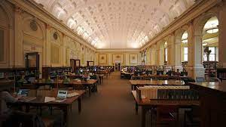
Image of Carnegie Library
Carnegie Library
Notes:
Social Settlements boomed from the 1890-to the 1920s, and by its end, the focus was on the purpose of adjuncts to universities. During this time the library profession, most notably the Carnegie Library which grew from the first establishment of museums, began to realize its stake in providing education leading to the establishment of special services for readers and organizations.

Slide 28
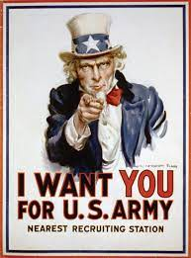

Image of military advertisements
Notes:
Public Education for Adults as we know it today sorta of began after WWI because illiteracy was found to be a concern with the possible endemic of the US armed services. It was during this time we see the uses of taxes to establish night schools, part-time schools, and moonlight schools, all to educate adults. With the use of taxes, the US government began literacy crusades, and the great Americanization began which negatively affected ESL programs and Citizenship education. These programs were inundated with remnants of white supremacy culture. As the crusades phased out, America saw a need to move beyond functional literacy which at that time was only writing one's name and composing simple sentences. Because of this push, the Department of Adult Education was born, and the Office of Americanization aka the Department of National Education Associates, was sunset.

Slide 29
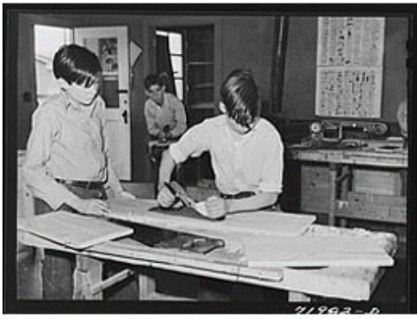
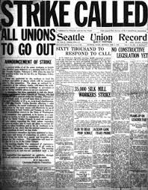
Images of newspaper
Notes:
In 1917, the Smith-Hughes Act was enacted for vocational training in secondary schools and out-of-school youth (resembling Job corps & GED training today). During this time, we see adult education services and training privatized.
With privatization came the came the fight for funded workers' education training, apprenticeship training based on union labor skills. This grew the establishment of labor colleges in urban communities, and in 1921, the Workers Education Bureau of America was started. Unions fought and won funding through the Congress of Industrial Organizations and the American Federation of Labor. From this work, we see the American worker's education movement build and we see the fervor of union collaboration to this day, think of the work Starbucks who has steadily been in the news, Hollywood, your unions and others.

Slide 30
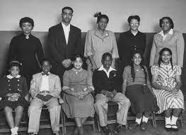
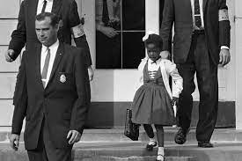
Images of Brown v Board plaintiffs and Ruby Bridges
Ruby Bridges – William Frantz Elementary 1960
Brown v. Board (1954) Plaintiffs
Notes:
The 1950s-1970s brought on the Civil Rights Movement, and in 1954, we see the most impactful legislation being enacted centered on race and education, Brown v. Board of Education. Brown v BOE was the response to Plessy v Ferguson which authorized white space.

Slide 31
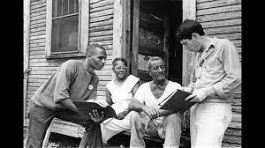
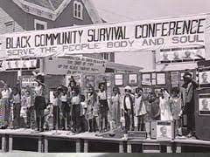
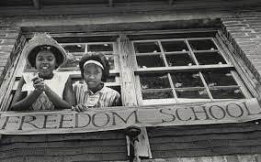
Images of Black Community Survival Conference
Notes:
In the early 60’s we see the greatest educational improvement for Black and other people of color with courses and curriculum on literacy, voter registration, citizenship and political and social awareness. Skills and knowledge training was introduced by what was known as the Freedom Summer Project in Mississippi. During this time, Adult Education becomes the most reliable instrument for social actionist. While we see that todays Adult Education programing is often shackled to curriculum for ESOL, there was the larger educational enterprise of learning the language of democracy, the meaning of citizenship, the pride of Black heritage, the responsibility of leadership, and the transformative power of self-respect.
We also see skills and labor training during the mid-60’s being introduced by the Black Panther party. Liberation schools have often been billed as being for children’s education, but many social programs were born out of the Liberation Schools which also focused on the education of adults in skills, vocational and literacy training. We would see many of these education programs flourish well into the 90s, though the Black Panther party would be extinguished. The Black panther’s work influenced the introduction and growth of community-based and worker-centered programs. During this period, there was a surge of social-justice-oriented adult education programs and training in the US which were all (once again) based and influenced by the civil rights era literacy programs.

Slide 32
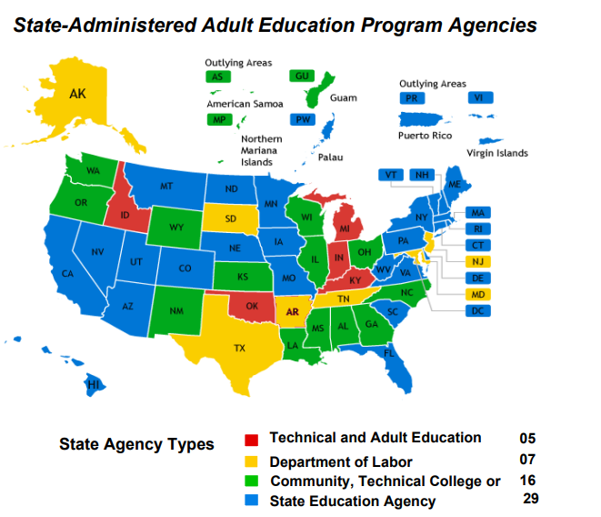
History of “adult education”
It is a federally-funded program
Focus on anti-poverty, getting students GED and/or English language
Different states fund in different systems. 15 or so in the colleges, most are in k-12.
Because program is subsidized by federal dollars, does not charge college tuition and is not financial aid eligible.
Notes:
Adult Education Programs are federally funded. These programs focuses on, anti-poverty, literacy, civics education, and workforce skills training. Washington is one of 15 states that houses adult education within its college system. Georgia, my home state is another as you can see. Many Adult Ed programs can be found in K-12 system throughout the country. A way Adult Ed provides economic justice to adult learners is by providing educational services to adult learners at no cost due to programs being subsidized federally.

Slide 33
Shifting the Gaze here at Home
Federal investment in adult education
  1966 Adult Education Act, 2014 Workforce Innovation and Opportunity Act
State vision for adult education
  1967 Community College Act, 1991 update brought in adult education, 2010 affirmed I-BEST as a leading strategy.
Notes:
Washington state’s community college system was born in 1967, with the passage of the Community College Act. The legislature passed the act to “provide for the dramatically increasing number of students requiring high standards of education” for all postsecondary programs, including academic-transfer and workforce.
Adult Basic Education’s story really begins in 1991, when the legislature amended the Community College Act as the Community and Technical College Act to include vocational-technical schools, rebranded as technical colleges, and to formally “provide for basic skills and literacy education.” This state legislation coincided with the passage of the federal National Literacy Act of 1991 and was a critical first step in aligning state and federal policy to further what Mike Rose described as the “promise of a second-chance society.”
In the late 1990s, we see one of the first iterations of the Workforce Innovation and Opportunity Act, formally known as the Workforce Investment Act 1998. And then it’s reauthorization in 2014.
In 2014, in WA the Adult Basic Education office rebranded itself as Basic Education for Adults: BEdA. This name change strategically aligns with the call out Title II programs as providing “Basic Education for Adults” in concert with the basic education that is being provided through K-12. One of our key legislative priorities would direct the Caseload Forecast Council to estimate the number of full-time equivalent students aged 18 to 44 who will enroll in Basic Education for Adults programs statewide. Estimates would allow colleges to more effectively serve students, increasing access, support, and program completion, ultimately helping students transition to college-level programs and into the workforce.
WA state currently funds 30 college districts and 5 community-based organizations to provide Title II services. We have in all 39 BEdA providers throughout our state.

Slide 34
Inclusion of Developmental education
Dev Ed evolved out of the colleges because students who came to the campus weren’t “college-ready”
Students who already had their HS diploma but tested below college level, perhaps HS education wasn’t the best, perhaps it had been a decade or more since attended.
Charges full college tuition and is financial aid eligible (not subsidized by federal dollars.)
Notes:
There is a difference in Adult Education and Developmental Education, though most DE courses are often taught in Basic Education for Adults Programs. Unlike Adult Ed, Developmental Education is not subsidized by the feds therefore, these courses charge full college tuition and are finical aid eligible. Some colleges provide DE courses with AE which is some instances allows those who are college ready to beef up their academic skill set for college entry.

Slide 35
What’s the difference in students?
Standards v Outcomes
Adult Ed and faculty working together
Keep in mind the guided pathway principle
Notes:
What’s the difference in what some may consider traditional college students who enter in from the front door and Adult Education students who are often served through the side and back doors, oftentimes, it’s more about how the programs are funded than it is about differences in students. Many English language learners are highly educated but need the English skills. And having/not having a hs diploma is not necessarily a determiner of whether a student could be successful at college level. The value we put into Adult Ed benefits the whole of the college and WA CTC system.
Adult education programs are grounded in the college and career readiness standards (CCRS.) Math departments are grounded in department outcomes that derive from various sources guided by local faculty. Both academic and Adult Ed practitioners should collaborate to create successful articulations and pathways that start with BEdA. A good first step in adult ed and academic faculty working together is to take a look at the CCRS and department outcomes and notice how they can complement and work together, in addition to looking at curriculum. We must keep in mind the guided pathway principle of making colleges “student ready” - what programming will best support student success regardless of their starting point?

Slide 36
College system mission and enrollments
Basic Education for Adults comprises 1/3 of the college system mission: BEdA, Workforce Education, and Academic Transfer
BEdA students total 15% of college system enrollments and are counted as state-funded FTE for the colleges.
Notes:
We must remember that the CTC system mission revolves around three mission areas. Workforce Education, Academic Transfer and Basic Education for Adults. To accomplish our mission, BEdA cannot be an after thought.

Slide 37
Basic education for adults in a nutshell
Students enroll to learn English, earn a High School credential, and transition to career pathway programs and the workforce.
26,251 participants served
English Language Programs: 12,466
Adult Secondary Education: 6,165
Integrated Education and Training: 3,761
BEdA's mission is to offer culturally responsive and equity focused college and career pathways that address barriers and enable students to obtain meaningful employment, meet workforce needs, and reduce economic disparities.
Notes:
BEdA's mission is to offer culturally responsive and equity focused college and career pathways that address barriers and enable students to obtain meaningful employment, meet workforce needs, and reduce economic disparities.

Slide 38
Vision of BEdA
To advance racial and economic justice, Basic Education for Adults provides equitable programming for all Washingtonians to realize their potential as they launch on a supported college and career pathway to living-wage employment and strengthen the vitality of their communities.
Notes:
BEdA's vision meets the efforts of our system to catch our adult learners seeking elevation through academics and other skills training. As a unit, we are focused on supporting our students as they launch into training which aids in obtaining living wage employment, in effect leading to a strengthened and vitalized community. BEdA is about the education and empowerment of all adult learners, while focusing on policies and practices that have disproportionally affected Blacks, Native Indigenous, Hispanic and other students of color.
Oftentimes Adult Education often operates with limited advocacy, budgeting, professional staffing, training, and variable facilities. Yet, the objective of adult education is to adjust to social injustice and empower all disadvantaged adult learners. With this in mind, adult learning is strongly affected by all social, cultural, structural, and personal factors. Adult education mirrors the world around us and can be easily shifted into reproducing and maintaining the status quo. Our adult education practice must be based on the understanding that the power relationship that structures our social lives cannot be checked at the classroom door. As professionals, we dream of a future where our classrooms, programs, journals, and conference participation mirror the diversity of our society.

Slide 39
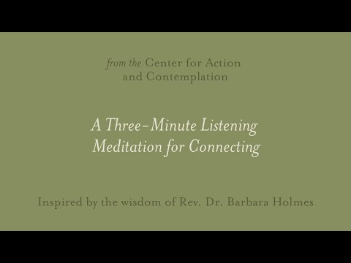
A Moment to Recenter….

Slide 40

Call to Action
How have you collaborated with your Basic Education for Adults team?
Is there a pathway into your program that begins with Basic Education for Adults programs?
That’s all folks…
Go beyond your imagination and strive for greatness
Do something to promote positive change
BE authentically you, while doing it.
Notes:
It is impossible to review the history of the US without recognizing adult education's role in providing a site for reflection, analysis, and strategizing for action to secure social justice. Even more so how adult education programming and services were built off the progression of the Civil Rights Movement. Adult Education supports social justice for adult learners by helping them to develop tangible assets to address systemic barriers to success in work, family, civic, and academic roles.
Just things to think about as you leave and transition:

Slide 41
Adult Education is
Social and Economic Justice
MarcusAntonio Gunn
Policy Associate, Basic Education for Adults
EDI & Barrier Mitigation
magunn@sbctc.edu
Thank you!

