Slide 1
Making teamwork work
A View From Auditing: We are All in this Together
Presenter: Shelia Sloan, SBCTC
Date: July 13, 2023 (revised Jan. 19, 2024, to add Separation of Duties matrix links)

Slide 2
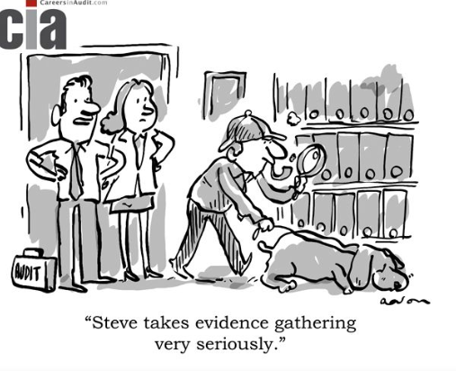
Housekeeping
Please ensure your line is muted
Please use the Chat function to ask questions during the presentation
Questions will be monitored and addressed during the presentation
There will be an additional Q&A at the end of the presentation as time allows.

Slide 3
Agenda
What is an IT Audit?
Types of IT Audits Performed
Information Technology (IT) General Controls
Segregation of Duties (SOD) and Mitigating Controls
Tips and Tricks for Institutions
Q&A

Slide 4
What is an IT Audit?
The evaluation of an organization’s information technology internal controls with respect to confidentiality, integrity, and availability.

Slide 5
Types of IT Audits Performed
Financial Statement Audits
  Performed by external auditor
Internal Audits
  Institution's internal audit
Compliance Audits
  Could be performed by external or internal auditors

Slide 6
Benefits of an IT audit
Identify and allow mitigation of IT risks
Enhances internal control environment
Improves internal operations
Identifies potential vulnerabilities

Slide 7
IT General Controls (ITGCs)
ITGCs are controls that apply to all systems components, processes and data for a given organization or IT environment.
ITGCs include IT risks associated with areas such as the IT environment, change management, access controls, data backup and recovery, and third-party providers.

Slide 8
Change Management Risks
The process that management uses to identify, document and authorize changes to an IT environment.
Risks
Unauthorized direct changes to application code or configuration settings
Failure to make necessary changes to systems or programs
Updates to the IT environment prevent applications from running correctly
Changes that introduce errors into applications

Slide 9
Change Management Internal Controls
Review controls around Change Management to provide reasonable assurance that changes placed into production are:
  Appropriately authorized, tested and approved
  Proper segregation of duties are in place between development and production
  Monitoring of production environment for inappropriate changes

Slide 10
Logical Access Risk
The process used to access IT environment.
Risks
Unauthorized users have access to the system
Authorized users with inappropriate access
Inadequate segregation of duties
Inappropriately configured password and/or security settings
User access accountability

Slide 11
Logical Access Internal Controls
Review controls around Logical Access to provide reasonable assurance that user access is restricted to functions in alignment with job responsibilities:
  Passwords are configured appropriately
  Privileged users' access is appropriate
  Periodically review user access to ensure access remains appropriate for job responsibilities
  Access is appropriately provisioned to users based on job responsibilities
  Access is appropriately de-provisioned from users when job responsibilities change or upon termination

Slide 12
IT Operations Risk
Systems or programs may not be available for users or may not be processing accurately.
  Data may be lost or corrupted resulting from improper migration/conversion or backup/recovery practices.
  Errors in transaction processing are not corrected and/or identified resulting in the recording of inaccurate/incomplete financial data.
  Interface/batch schedules may be inappropriately changed.

Slide 13
IT Operations Internal Controls
IT Operations – Review controls related to the complete and timely execution of data backups, scheduled jobs, interfaces, and incident/problem management.
  Ensure scheduled jobs including backups are executed successfully
  Make sure access is appropriate for users with the ability to modify backup and automated job schedules
  Verify that backed-up data is recoverable

Slide 14
Segregation of Duties (SOD)
Key Component of Institution’s Internal Control
Assigning Key Duties/Responsibilities to different personnel to reduce risk
Risks include
  Error
  Misuse
  Fraud

Slide 15
Segregation of Duties (SOD)
Prohibit assignment of responsibility to one person for the acquisition of assets, their custody, and the related recordkeeping. There should be at least two sets of eyes on each transaction.
No one person has sole control over the lifespan of a transaction. Ideally, no one person should:
  Initiate the transaction
  Approve the transaction
  Record the transaction
  Reconcile the transaction
  Handle the related asset
  Review reports

Slide 16
Segregation of duties
Another example is to separate the following responsibilities in each business process:
  Custody of Assets
  Record Keeping
  Authorization
  Reconciliation
Ideally, no individual employee should handle more than one of the above noted functions in a process.
Notes:
Custody is the process of having access to, or control over, any physical asset such as cash, checks, equipment, supplies, or materials.
Some examples are: Access to any funds through the collection of funds or processing of payments. Access to safes, lock boxes, file cabinets, etc. Custodian of a petty cash fund Receiving any goods or services Handling or distributing paycheck
_________________
Authorization is the process of reviewing and approving transactions or operation
Some examples are: Verifying cash collections and daily balancing reports. Approving purchase orders. Approving time sheets, payroll certifications, leave requests and cumulative records. Approving change orders, computer system design or programming changes
To ensure proper segregation of duties, the person initiating a transaction should not be the person who approves the transaction
_______________________________
Record-keeping is the process of creating and maintaining records of revenues, expenditures, inventories and personnel transactions. These may be manual records or records maintained in automated computer systems
Some examples are: Preparing cash receipt back-ups or billings, purchase requisitions, payroll certifications and leave records. Entering charges or posting payments to accounts receivable system. Maintaining inventory records
Documentation and record retention is to provide reasonable assurance that all information and transactions of value are accurately recorded and retained. Records are to be maintained and controlled in accordance with the established retention period and properly disposed of in accordance with established procedure
________________________
Reconciliation is verifying the processing or recording of transactions to ensure that all transactions are valid, properly authorized and properly recorded on a timely basis. This includes following-up on any differences or discrepancies identified.
Some examples are: Comparing billing documents to billing summaries Comparing funds collected to accounts receivable postings Comparing collections to deposits Performing surprise counts of funds Comparing payroll certifications to payroll summaries Performing physical inventory counts Comparing inventory charges to amounts purchased Reconciling departmental records of revenue, expenditures and payroll transactions to management reports

Slide 17
Segregation of Duties
Determine, both organizationally and logically, that different individuals/system resources perform the following duties related to granting user access
  Requesting access
  Approving access
  Setting up access
  Monitoring access
Other examples of conflicting Segregation of Duties
  Enter Employees
  Change Compensation
  Cut payroll checks
  Modify user access

Slide 18
Segregation of Duties –HCM
  More Examples
      ZZ HR Employee Maintenance
      OR ZZ Payroll Data Maintenance
      PLUS, ANY of these:
            ZZ Time and Labor Admin
            ZZ TL Process Time
            ZC Admin Enroll Time Reporters
  Segregation of Duties Matrix for HCM
Notes:
When talking about Segregation of Duties , it is important to understand the Risk Areas within Application and understand what security roles compromise the access to those areas. It is also important to know what queries are out there to monitor any SOD issues and how to respond to issues that arise. If there are not adequate resources to disperse the job duties, then we will talk about how to implement mitigating controls and monitoring.
In HCM, you don’t want the same person that can hire/terminate/update an employee to be able to also approve those type changes. It should be reviewed by a supervisory level employee that is not the same person that is entering the data. A compensating control here could be to generate a report of all changes to the employee master file and have a supervisory level person review it and match the changes to approved personnel action forms.
This type person should also not be involved in the Payroll process, or the distribution of payroll checks and should not be involved in hiring / termination type decisions. A compensating control could be to have a supervisory level employee not involved in the payroll process review and approve pre-payment payroll reports and final payroll reports. Distribution of the payroll checks should be conducted by someone without payroll responsibilities and ensure checks not distributed are investigated.

Slide 19
Segregation of Duties - HCM
  More Examples
      ZZ HR Employee Maintenance
      OR ZZ Payroll Data Maintenance
      PLUS, ANY of these:
          ZZ Central Payroll Processing (SBCTC role only)
          ZZ Payroll Support (SBCTC role only)
Notes:
Also you should consider does the person responsible for recording the payroll expense entry in the general ledger perform any of the following functions: modify employee master file, prepare or authorize payroll, generate or distribute payroll checks? An employee outside the HR and payroll offices should be posting the payroll journal entry to gl.
These are just a few examples of segregation of duties and a few examples of mitigating controls.

Slide 20
Segregation of Duties - HCM
HCM Security Role | Examples of System Access
ZZ HR Employee Data Maintenance | Access to Employee Master File (adding/modifying/terminating employees, changes to compensation)
ZZ Payroll Data Maintenance | Access to add/change/delete items in payroll module Prepare or authorize payroll Involved in payroll process Generate/Distribute payroll checks Review/Approve final payroll reports
Notes:
I have listed the main roles that would have conflicts and put a description of the access next to them. The ZZ HR Employee Data Maintenance is the main role for HR practitioners to modify the employee master file . The ZZ Payroll Data Maintenance role is the main Payroll role for the institutions to use to prepare or authorize payroll.

Slide 21
Segregation of Duties - HCM
HCM Security Role | Examples of System Access
ZZ Central Payroll Processing (SBCTC only) ZZ Payroll Support (SBCTC only) | Reconcile payroll to general ledger Post payroll journal entries to general ledger
Notes:
Here we have listed roles that would have access to reconcile payroll to GL and post payroll Journal entries to GL. ZZ Central Payroll Processing (SBCTC role only)
ZZ Payroll Support (SBCTC role only)

Slide 22
Segregation of Duties - HCM
HCM Security Role | Examples of System Access
ZZ Time and Labor Admin | Adjust Paid Time Generate Absence Payable Time Request Batch Approval Process Maintain Time Reporter Data Assign Schedule to Group
ZZ TL Process Time | Request Batch Approval Process Adjust Paid Time Report/Approve Time Timesheet
ZC Admin Enroll Time Reporters | Assign Work Schedule Create/Maintain Time Reporter Data
Notes:
These are the main Time and Labor roles that would have conflicts with the HR and Payroll roles.
ZZ Time and Labor Admin
ZZ TL Process Time
ZC Admin Enroll Time Reporters

Slide 23
SOD/Employee Compensation (HCM)
Control Consideration | Recommendation
Does the employee responsible for initiating modifications (e.g., add/delete employees, changes to employee information) in HCM also have the ability to approve or record these changes? | All changes to HCM should be reviewed and approved by a supervisor-level employee (other than the employee initiating the change) in the Human Resources department prior to being recorded in the system

Slide 24
SOD/Employee Compensation (HCM)
NOTE: Best practices suggest that no one employee should be able to record modifications to HCM. The modifications should be initiated by one employee and reviewed and authorized in the system by a separate employee.
Compensating Controls Example
A system report of all changes to HCM should be generated for review. A supervisory-level employee who does not have access to modify HCM should review this report and match the changes to approved Personnel Action Forms.

Slide 25
SOD/Employee Compensation 1 (HCM
Control Consideration | Recommendation
Do the employees responsible for maintaining HR data in HCM (e.g., adding/deleting employees, changes to compensation) also perform any of the following functions: Make decisions regarding hiring/termination of personnel Have access to payroll system or payroll module Involved in the payroll process Generate payroll checks Receive payroll checks for distribution | Employees responsible for modifying HR data in HCM should not have access to the payroll system, be involved in the payroll process, distribute payroll checks or make hiring or termination decisions.

Slide 26
SOD/Employee Compensation 2 (HCM)
Compensating Controls Example
To enhance controls over the payroll process, the following compensating controls can be used:
A supervisory-level employee who is not involved in the payroll process reviews and approves the pre-payment payroll report as well as the final payroll reports after the payroll has been processed.
Distribution of payroll checks is conducted by a supervisory-level employee without payroll responsibilities and checks not distributed are investigated.
Gross wages, per the payroll journals and the general ledger, are reconciled to the W-2s.

Slide 27
SOD/Employee Compensation 3 (HCM)
Control Consideration | Recommendation
Are employees able to review and approve their own hours worked or time entered in the timekeeping system? | Hours worked should be reviewed and approved by the employee’s supervisor prior to being recorded or transmitted to the payroll department .

Slide 28
SOD/Employee Compensation 4 (HCM)
Control Consideration | Recommendation
Do the same employees responsible for preparing payroll for processing also perform any of the following duties? Modify the Employee Master File Approve the payroll Generate payroll checks Distribute payroll checks Receive final payroll reports (e.g., payroll registers) for review and approval | The file prepared for processing payroll should be reviewed and approved by an employee who is not in the preparation of this payroll file of part of the human resource function.

Slide 29
SOD/Employee Compensation 5 (HCM)
Outside Payroll Service
NOTE: If an outside payroll service is used for payroll processing, the same employee responsible for communicating changes to payroll master file data to the outside payroll service provider should not be involved in:
recording the payroll entries in the general ledger,
preparing payroll reconciliations, or
distributing payroll checks.
This employee should also not receive the copies of the final payroll reports (e.g., payroll registers) from the outside payroll service.

Slide 30
SOD/Employee Compensation 6 (HCM)
Compensating Controls
To enhance controls over the payroll process, the following should be considered:
Use of an outside payroll service provider
Use of direct deposit instead of payroll checks
Perform a periodic analytical review of the payroll expense, including but not limited to budget to actual variance analysis
Perform an analysis of headcount to revenue ratios

Slide 31
SOD/Employee Compensation 7 (HCM)
Control Consideration | Recommendation
Are undistributed payroll checks and rejected payroll direct deposits investigated and reconciled by a supervisory employee outside of the payroll function in a timely manner? | Employees not involved in the payroll or human resource function should maintain custody as well as investigate and reconcile the returned payroll checks.

Slide 32
SOD/Employee Compensation 8 (HCM)
Control Consideration | Recommendation
Does the employee responsible for recording the payroll expense entry in the general ledger perform any of the following functions: Modify the Employee Master File Prepare or authorize payroll Generate payroll checks Distribute payroll checks | An employee outside of the payroll and human resources functions should post the payroll journal entry to the general ledger

Slide 33
SOD/Employee Compensation 9 (HCM)
Control Consideration | Recommendation
Is the employee responsible for reconciling the general ledger to the payroll system also able to record entries in or make adjustments to the payroll system? | Reconciliations should be performed by an employee who does not have modification rights to the payroll system

Slide 34
SOD/Employee Compensation 10 (HCM)
Control Consideration | Recommendation
When using an outside payroll service to calculate and remit payroll withholding tax, does the employee responsible for receiving the payroll tax refund checks perform any of the following functions: Prepare and process payroll, including but not limited to communicating changes in the payroll master file data to the outside payroll provider Authorize payroll Prepare payroll reconciliations | The payroll withholding tax refund checks should not be received by an employee who is involved in the payroll process

Slide 35
SOD/Employee Compensation 11(HCM)
Conflict | Recommendation
Employee should not be able to enter/change hours worked AND be able to hire, update, and/or modify employee data | Mitigating controls should be in place to review data entered or changed where SOD concern exists Identify employee time not approved by the supervisor Identify time approved/changed by individuals with SOD conflict Supervisor should review and confirm if correct

Slide 36
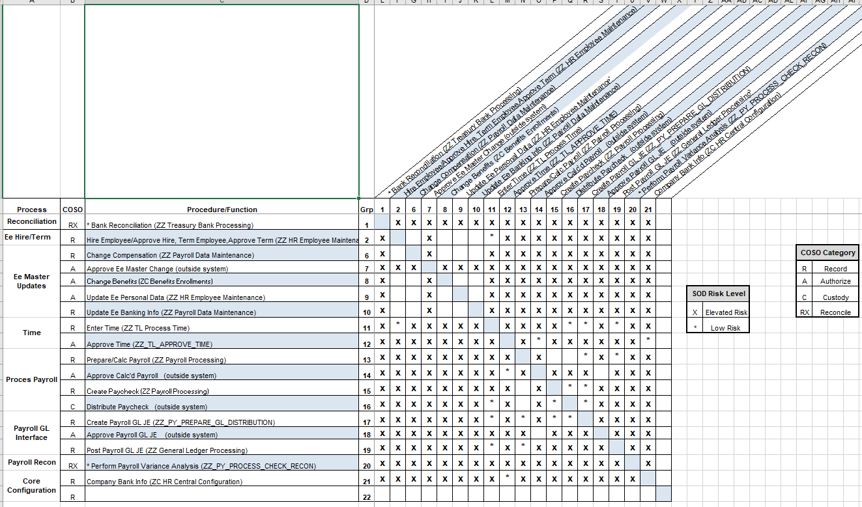
HCM Matrix
  Segregation of Duties Matrix for HCM

Slide 37
Roles Associated with SOD Areas - Financials
Process/Function | Associated Roles
Create Requisition | ZZ Requisition Entry
Approve Requisition | ZZ Requisition Approval
Create PO | ZZ Purchase Order Entry
Approve PO | ZZ Purchasing Approval (and AWE roles)
Create Voucher | ZZ Voucher Entry
Approve Voucher | ZZ Voucher Approval (and AWE roles)
Cut Check | ZZ Payment Creation
Add/Edit Supplier | ZZ Supplier Entry
Approve Supplier | ZZ Supplier Entry (with User prefs) SBCTC only
Bank Recon | ZZ Treasury Bank Processing
Enter Journal Entry | ZZ GL Journal Entry
Approve Journal Entry | ZZ GL Journal Approval (and AWE roles)

Slide 38
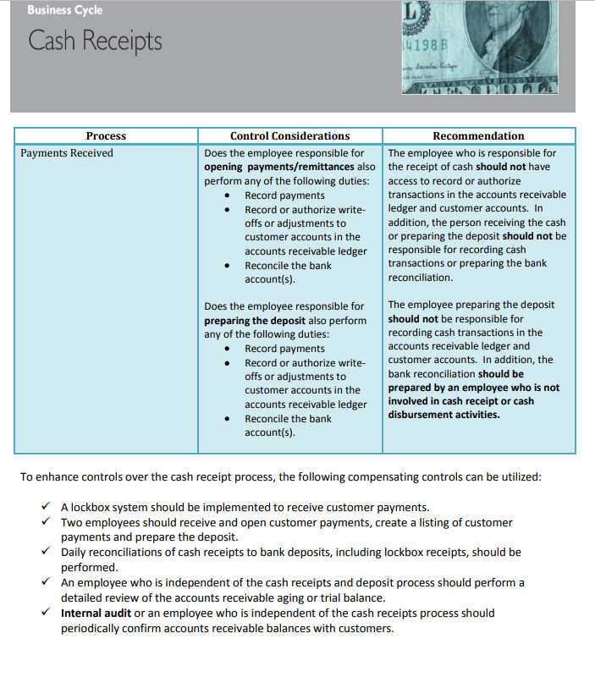
SOD Examples 1 (FS)

Slide 39
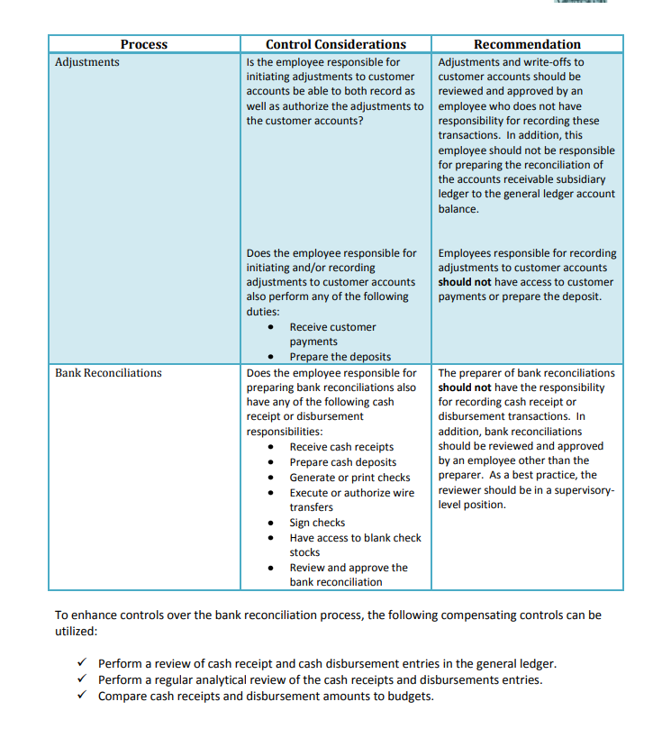
SOD Examples 2 (FS)

Slide 40
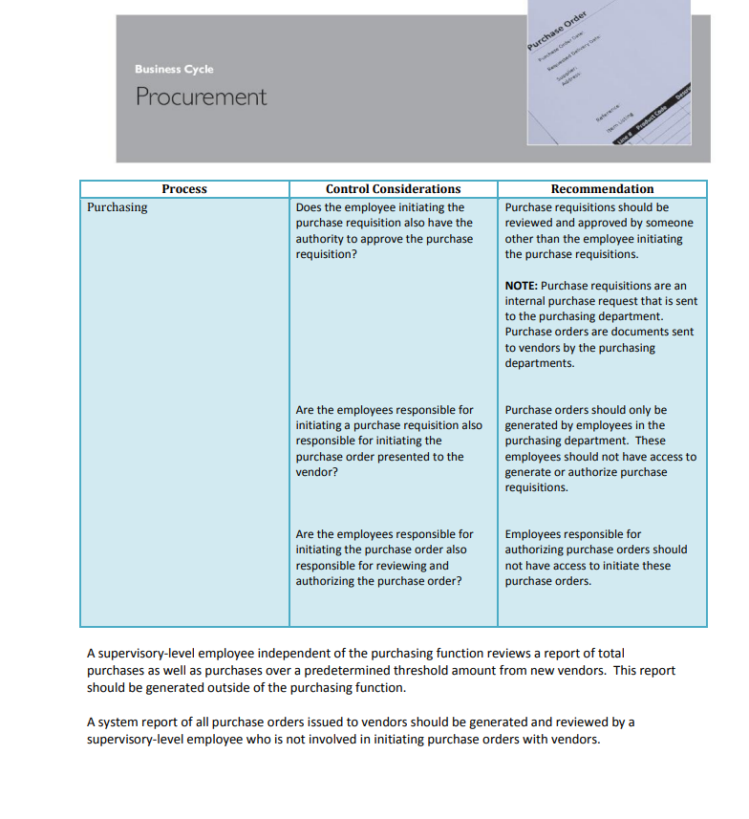
SOD Examples (FS)

Slide 41
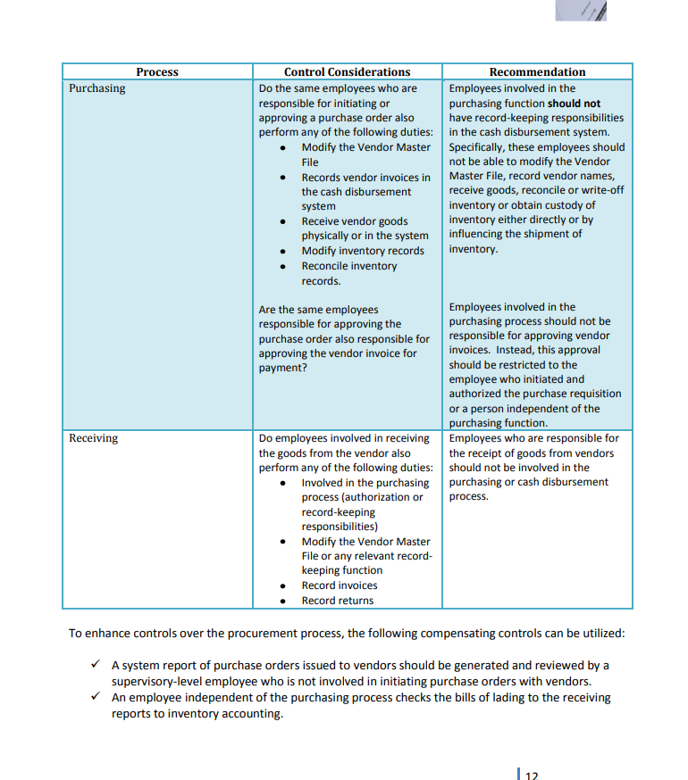
SOD Examples (FS)

Slide 42
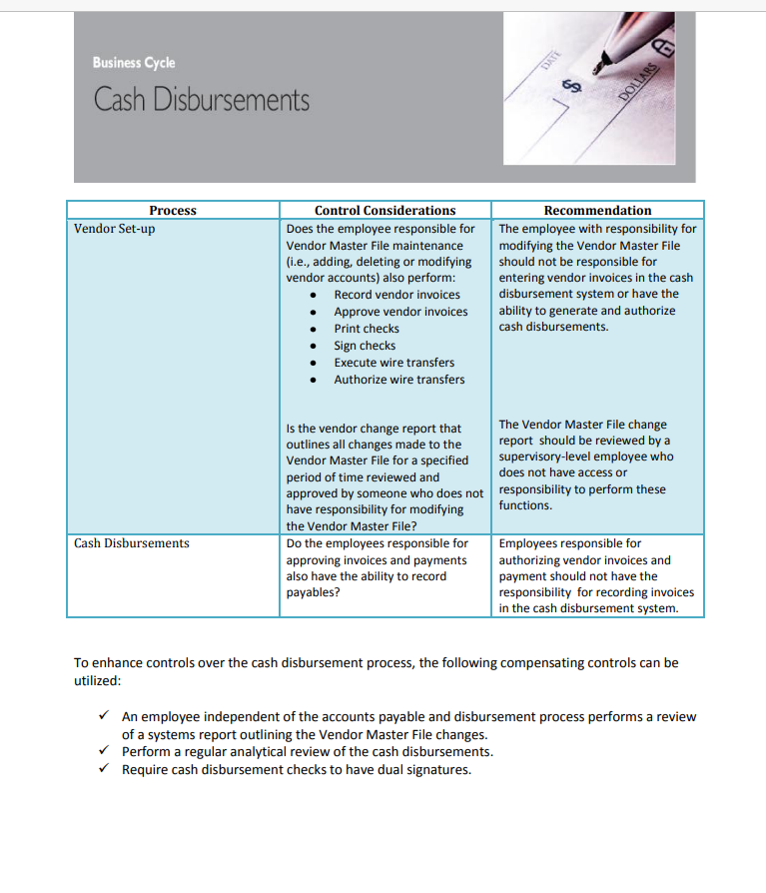
SOD Examples (FS)

Slide 43
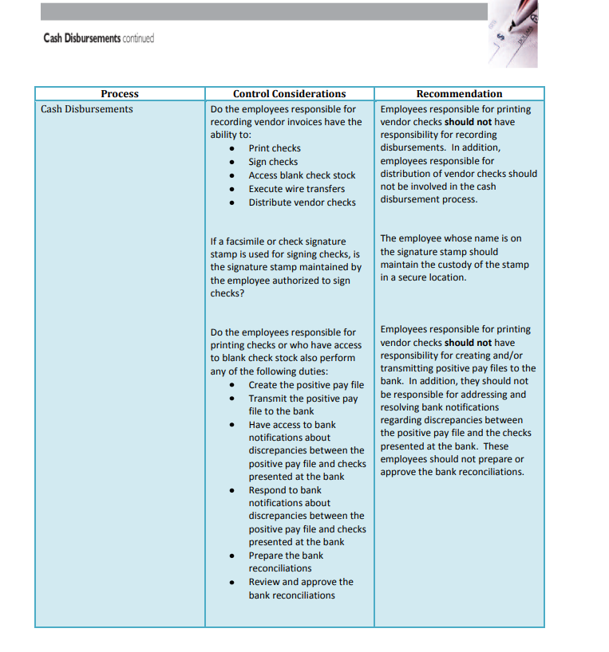
SOD Examples (FS)

Slide 44
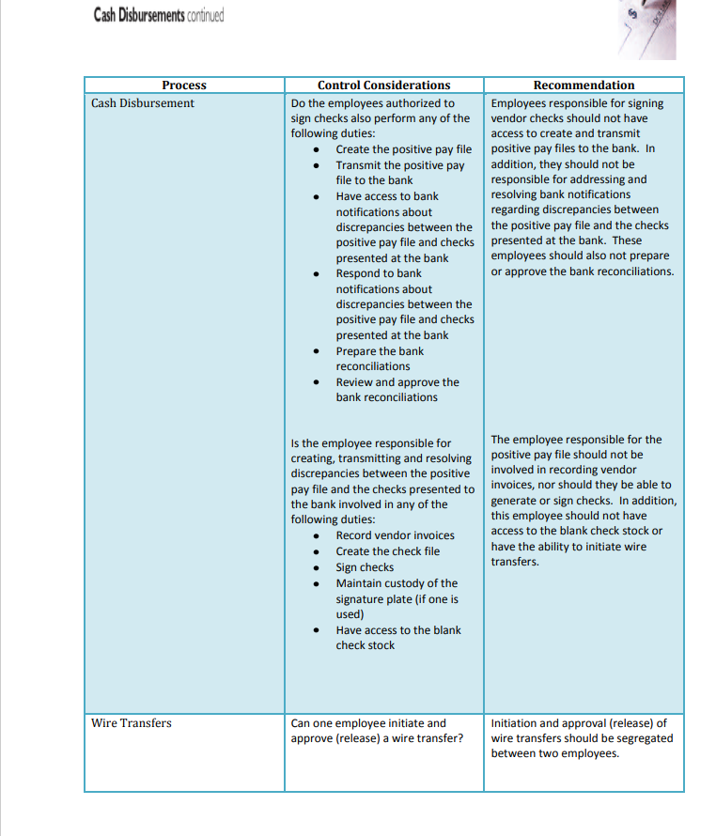
SOD Examples (FS)

Slide 45
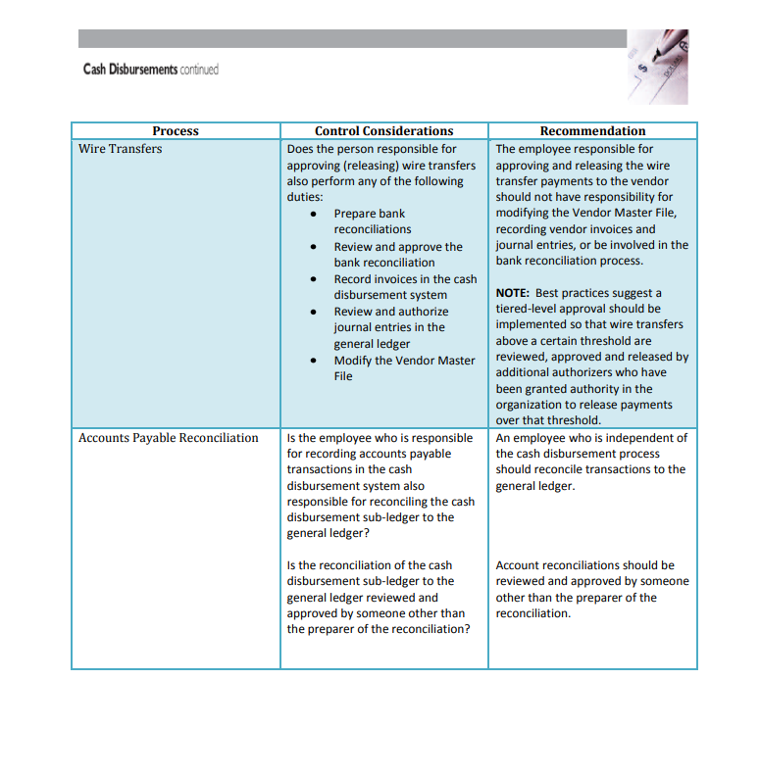
SOD Examples (FS)

Slide 46
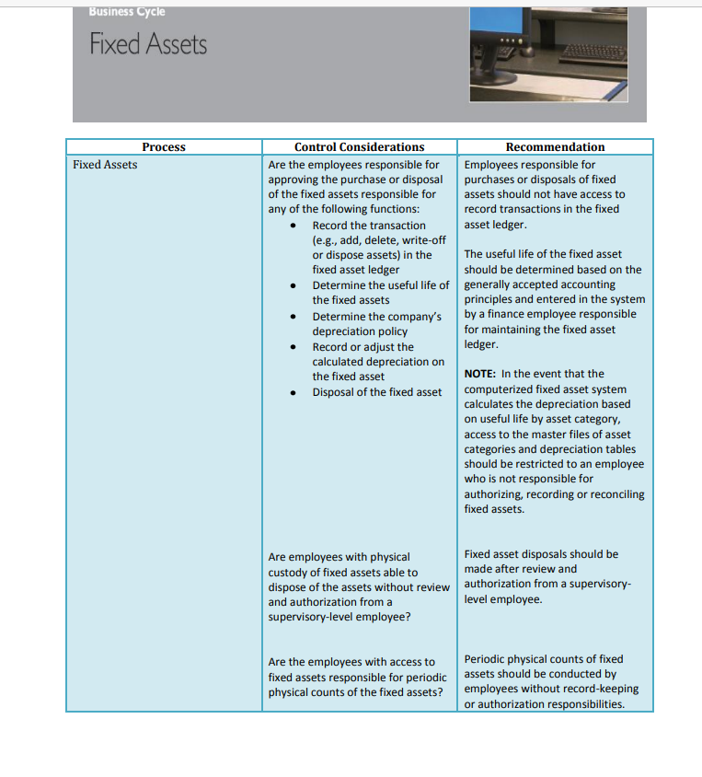
SOD Examples (FS)

Slide 47
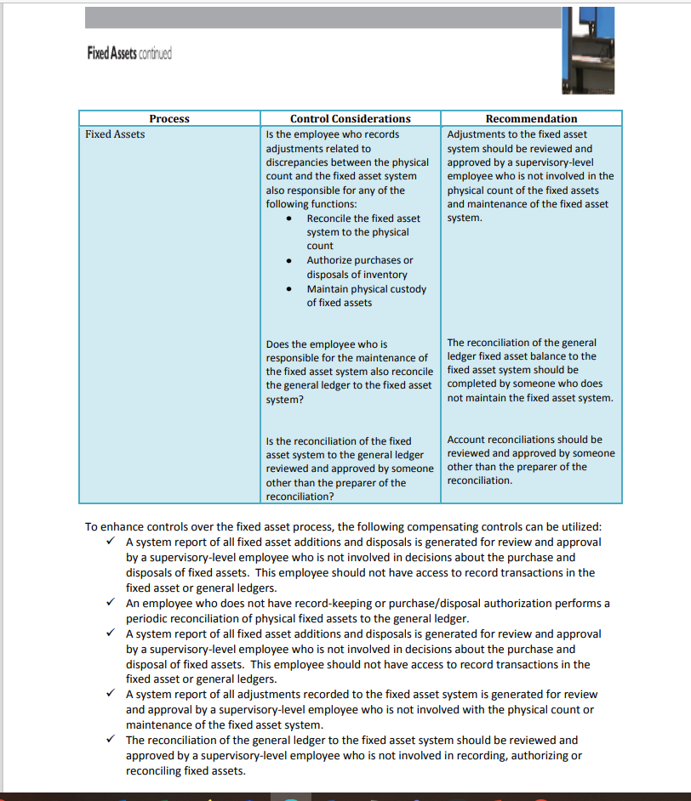
SOD Examples (FS)

Slide 48
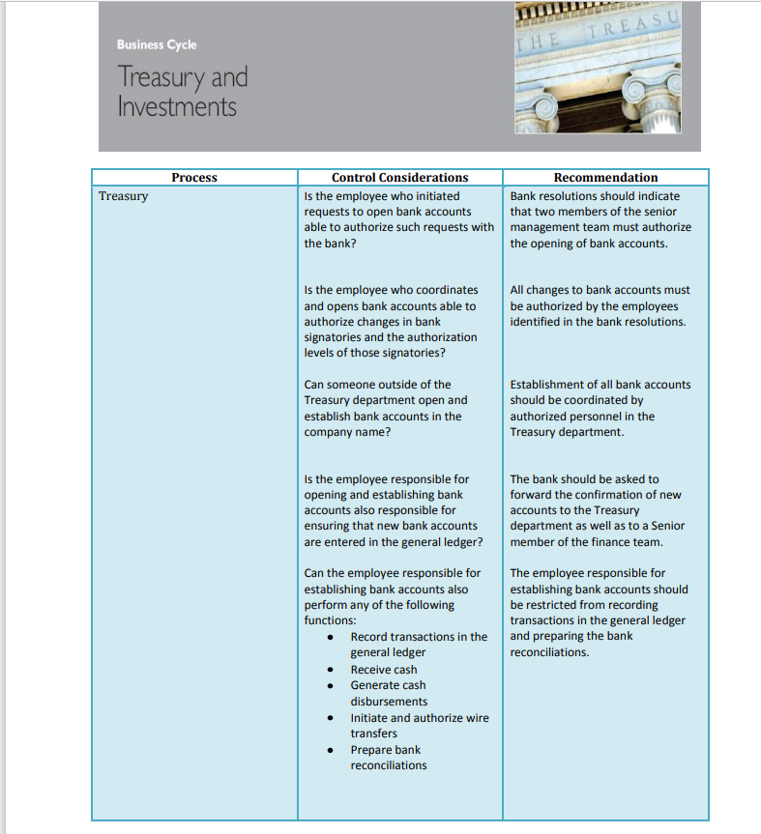
SOD Examples (FS)

Slide 49
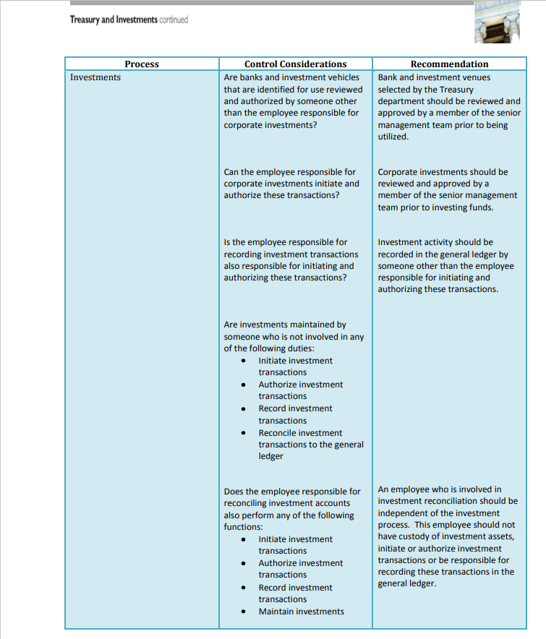
SOD Examples (FS)

Slide 50
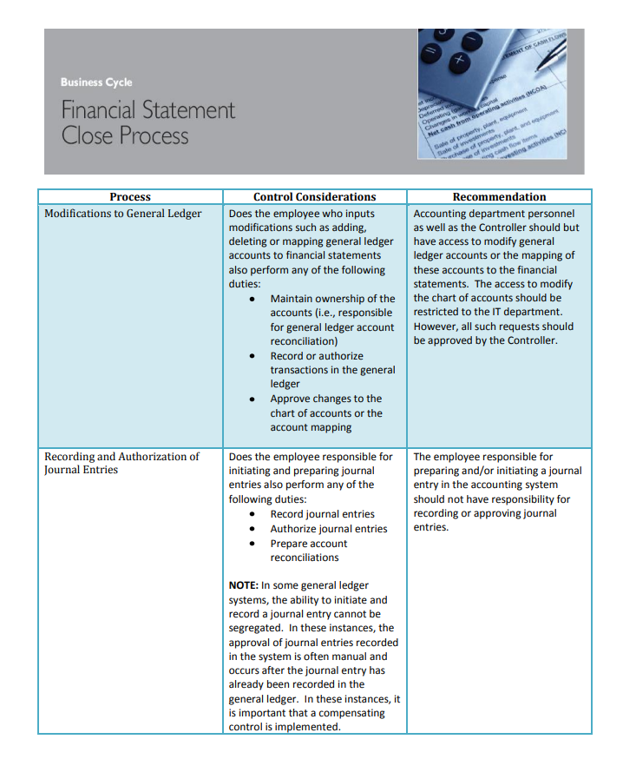
SOD Examples (FS)

Slide 51
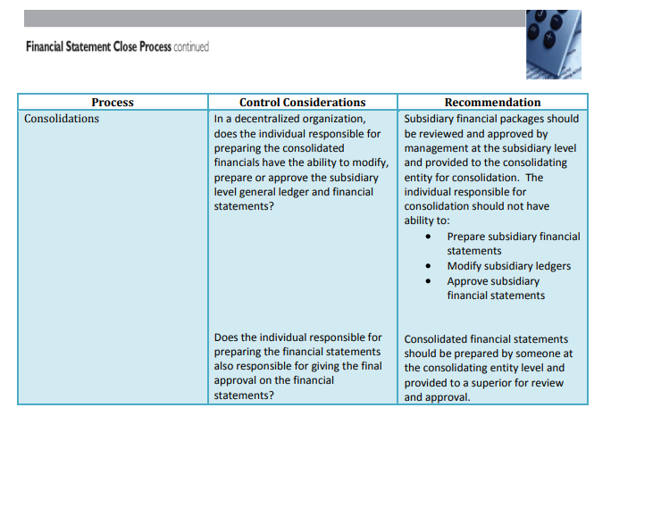
SOD Examples (FS)

Slide 52
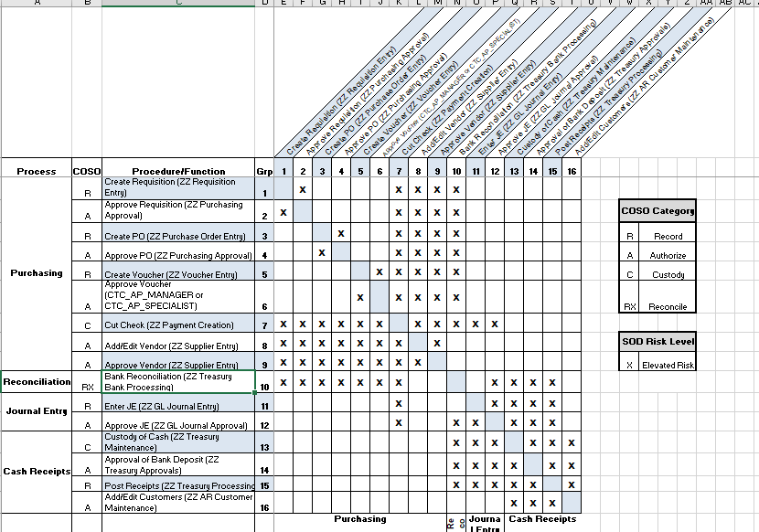
Segregation of duties Matrix (FS)
  Segregation of Duties Matrix for FS

Slide 53
Segregation of Duties (CS)
A Financial Aid user should only be given ZD roles to Student Financials type pages, with the exception of Higher One Student Data Page.
A Student Financials person should only get ZD access to Financial aid pages.
Segregation of Duties Matrix for CS

Slide 54
New Query: QCS_SEC_SEGREGATION_OF_DUTIES
Run this query to find compromising roles for your users at your institution
May need to consider SACR values in conjunction with these roles

Slide 55
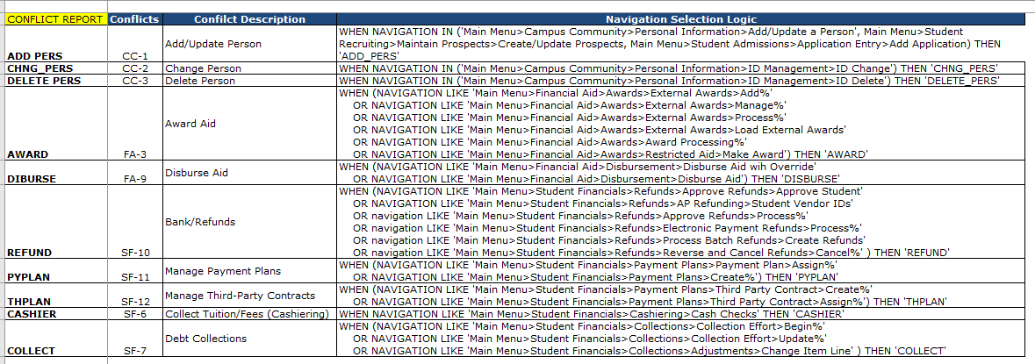
Segregation of Duties (CS)

Slide 56
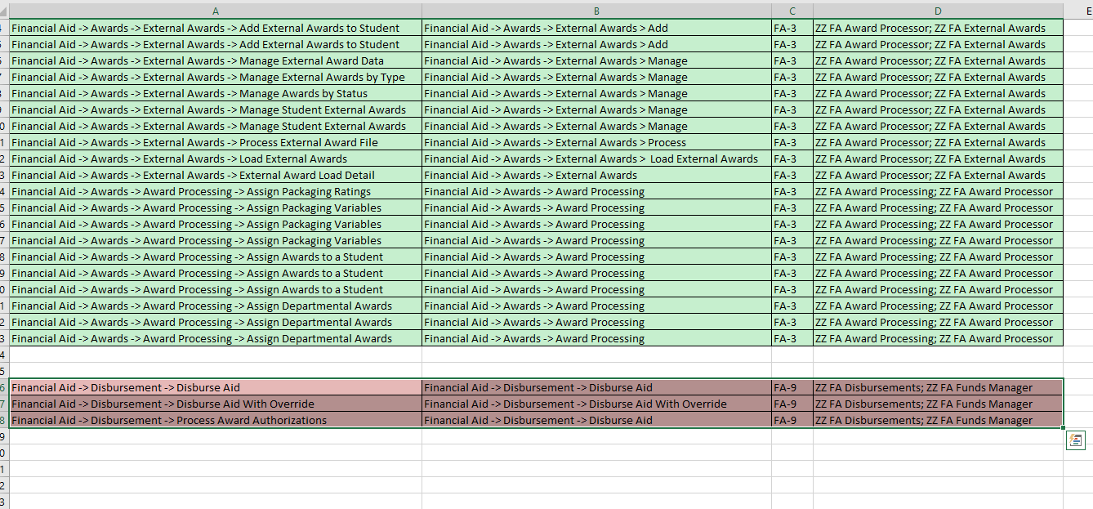
Segregation of Duties (CS)
Award/Disburse

Slide 57
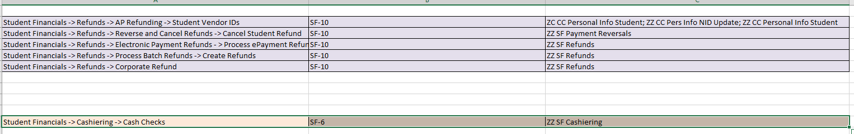
Segregation of Duties (CS)
Cashier/Refund

Slide 58
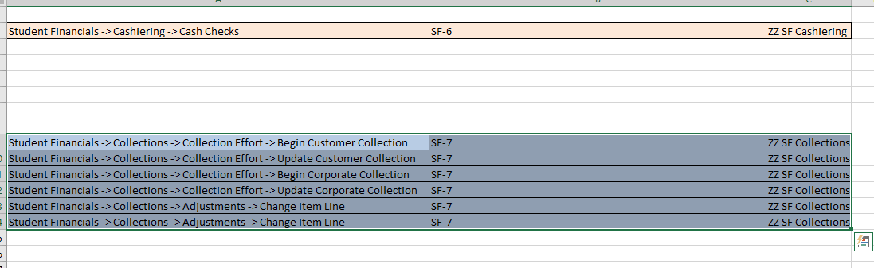
Segregation of Duties (CS)
Collect/Cashier

Slide 59
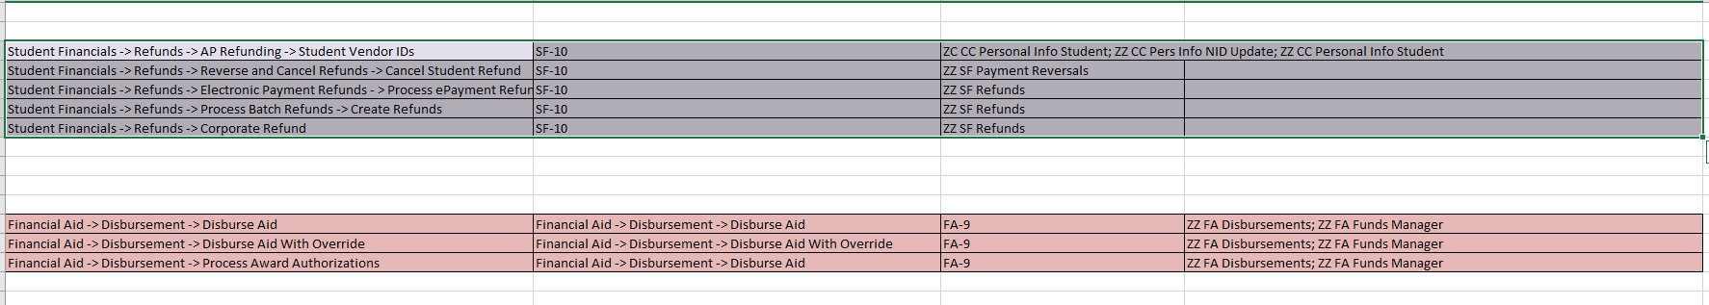
Segregation of Duties (CS)
Refund/Disburse

Slide 60
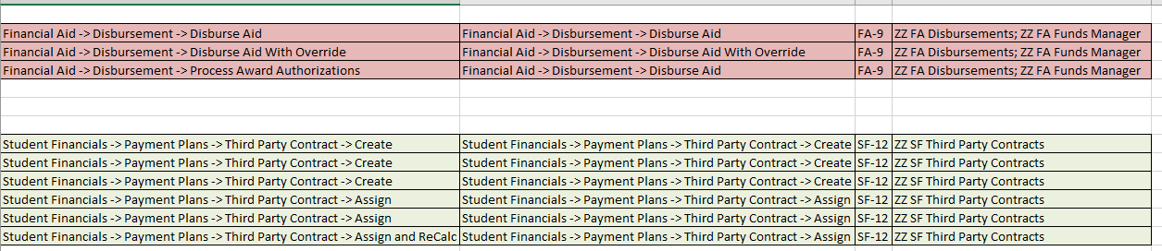
Segregation of Duties (CS)
Third Party Disburse

Slide 61
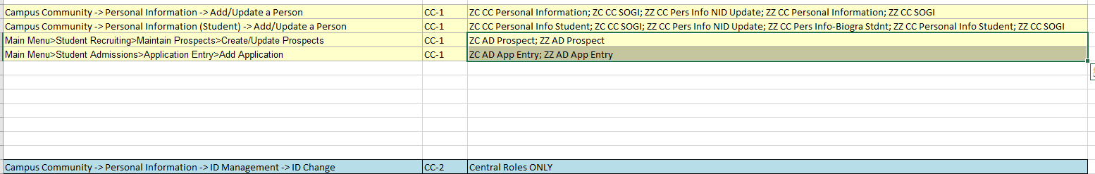
Segregation of Duties (CS)
Add/Change ID

Slide 62
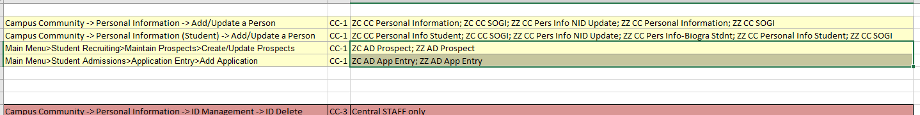
Segregation of Duties (CS)
Add/Delete ID

Slide 63
Tools for Evaluating SOD
Segregation of Duties (SOD) should be evaluated periodically
  at least twice a year but recommended quarterly
Documentation should include
  Who performed the evaluation and the date of the evaluation
  Who reviewed the evaluation and date of the review
  Processes/Procedures/Roles Evaluated
  All conflicted SOD issues noted through the evaluation
  Mitigating control in place that addresses each conflicting issue noted if not eliminated

Slide 64
Segregation of Duties (SOD)
When duties cannot be segregated, compensating controls should be considered
Compensating controls can be preventative, detective, or monitoring controls executed by an independent, supervisory-level employee.
There must be an audit trail for each compensating control.
When duties cannot be segregated through system access, system generated reports should be validated to source documentation outside the system.

Slide 65
Mitigating Controls
Log Reviews
Rotate personnel
Reconciliations
Identify anybody who has access to combinations of applications that enable them to violate the SOD rules.
Notes:
There are different ways to perform mitigating controls. Log files could be reviewed, audit records could be monitored and queried for data reconciliations. Rotating personnel that are responsible for the duties. Reports could be ran for data reconciliations.

Slide 66
Tips and Tricks
QUERY NAME: QHC_SEC_SEGREGATION_OF_DUTIES (HCM)
QUERY NAME: QFS_SEC_SEGREGATION_OF_DUTIES (FS)
QUERY NAME: QCS_SEC_SEGREGATION_OF_DUTIES (CS)
If a segregation of duties issue is noted, mitigating controls need to be in place or the user’s security access needs to be updated to remove the risk.

Slide 67
Other useful Queries in FS
QFS_SEC_EOAW_REQUEST_APPROVE
  Users that have both Requested and Approved on a specific transaction.
QFS_SEC_EOAW_ROLE_REQST_APPRV
  AWE setup that allows for user to have Requested and Approved on transactions.

Slide 68
HCM Payroll
QHC_PY_DIRECT_DEPOSIT_AUDIT and
QHC_PY_DIRECT_DEPOSIT_CHG_REV
Payroll should be reviewing these for changes before every pay run to see if the direct deposit changes appear to be legitimate.

Slide 69
New User Access
For Users that Transfer from Another Institution
Work with the Local Security Admin from the other institution to properly offboard from there and properly onboard at the new institution.
Best practice is for the old institution to FULLY offboard before new one onboards (in a perfect world).
Communication is KEY. WE are a system and MUST work together.
Check Row /Primary Permissions, Email Addresses, User Preferences, SACR and other secondary types of security for these users to update to new institution.

Slide 70
Current User Access
Periodically Review Current Users Access, at least twice a year.
  This is really recertification of user access
If job duties change, so should their access in the application.
Document the changes, gain authorization.
Ensure no segregation of duties issues are in place.

Slide 71
Terminated User Access
This should be handled on demand as users terminate but at least weekly.
Review Terminated users and confirm with HR that they are in fact terminated.
Coordinate with Security Administrator in HCM if Different to update roles to match the offboarding recommendations.
9.2 Employee HR Status System-wide (ctclink.us)

Slide 72
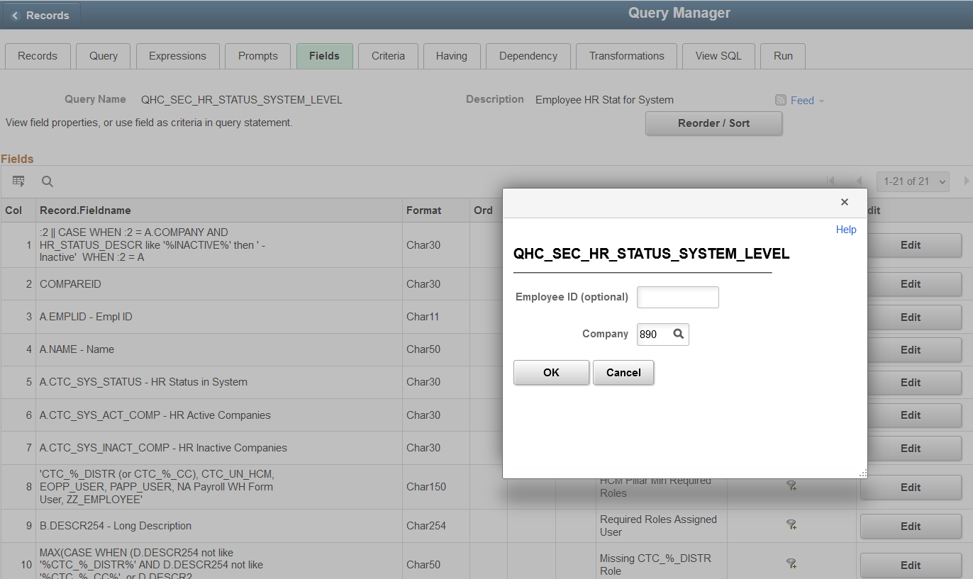
Offboarding
In HCM, run Query: QHC_SEC_HR_STATUS_SYSTEM_LEVEL
Prompt for your Company ID.

Slide 73
Offboarding
Download results to Excel; Sort by Company Query Prompt.
  This will sort by the employees that are inactive at your school and active. Then you can pull out the active ones.
  For the inactive ones, you will then need to sort by HR Active Companies.
If there are NO active companies, proceed with offboarding.
If they are active at a different institution, work with the local security admin there to properly offboard.

Slide 74

Questions?

