Slide 1
YEAR END PROCESSES & INTEGRATION: SPENDING OF ALLOCATIONS, GRANTS, ETC
SUE WILLIS, EXECUTIVE DIRECTOR BUDGET AND FINANCE, WWCC

Slide 2
GRANT & CONTRACT SPEND DOWN
Meet early with grant managers to ensure that grants and contracts are fully utilized and spent and that:
Projections are provided
OBIS adjustments are kept up to date
Final OBIS adjustment matches spend down plan
All OBIS adjustments are made shortly after May month end close
WWCC bills all outstanding grants in OBIS for May and June expenditures at one time
Accruals are submitted at the same time as the final OBIS billings are submitted
In addition to FMS Query, test close/open is used to ensure that accruals are correct and that staff have not miscoded an expense to a closed grant

Slide 3
COMMUNICATION IS KEY
Communication with the college community and your co-workers is important
At WWCC, weekly emails are sent during the year end close process
We have a published schedule of cutoff dates (Copy of Code Book.xlsx)
Staff communicates with one another and know who is responsible for review of specific accounts
Encumbrances are liquidated two to three days prior to June 30

Slide 4
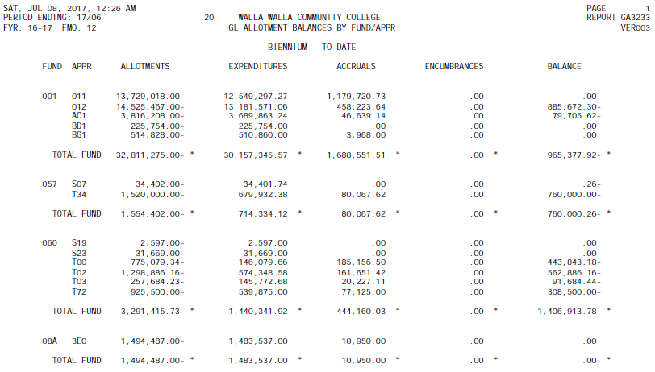
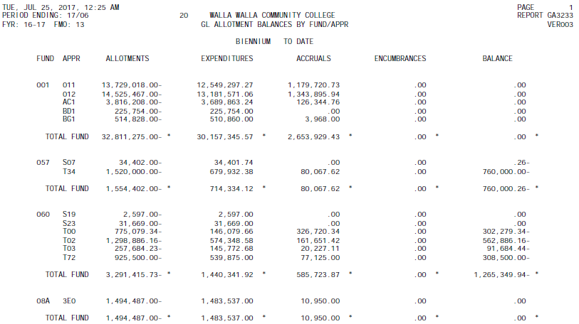
WWCC continues to spend state allocations through the year end process. We monitor the GA3233 as we are finalizing the expenditures.
GA3233 Prelim Close
GA3233 Final Close

Slide 5
COMMON BUDGET REPORTS USED BY WWCC
These commonly used reports normally do not contain Grant & Contract/Capital transactions
BA1201 – Budget Status Report
BA1202 – Budget Status Report District by Division (This is organized by the second digit of the Org Index and usually does not include Grant and Contract/Capital accounts in the reports.)
BA1203 – Budget Status Report District by Program
These reports contain information on all accounts
BA1209 - Budget Change Register by Program Index and Organization Index
BA1210 – Budget Change Register by Revision Number
BA1211 – Salary and Wage Expenditure Report
GA2103 – Detail Revenue Report (This is for the month)
GA3230 – Detail Expenditure Report (This is for the month)
PS1120 – Payroll Processing Transaction List
These reports only contain Grant & Contract/Capital information
PM1201 - Budget Status Report - Grant & Contract/Capital Projects

Slide 6
Questions?
Thank You!

