Slide 1
Strategic Technology Advisory Committee
Report for WACTC-Tech
6/4/20
AGENDA
Strategic Goals and Strategies
Current Priority Issues
Framework for Recommendations
CampusCE Example
ctcLink and Accessibility
Other Areas of Focus

Slide 2
Strategic Goals and Strategies
Strategic Planning Horizon
Strategies
Years 1-3: 2020 - 2022 | Years 4-5: 2022 - 2024
ctcLink Implementation & Stabilization for all colleges Guided Pathways - focus on strategic uses of ctcLink & identify gaps | ctcLink Optimization & Integrations* Guided Pathways - address gaps & new opportunities
Continually Monitor Emerging Trends in Higher Education
Integrations: Assure that foundational Enterprise Systems (ctcLink) are in place for all colleges before building two-way integrations with third-party systems
Guided Pathways: Identify and prioritize gaps in ctcLink functionality before acquiring and integrating third-party solutions
Accessibility: Focus on accessibility of Enterprise Systems and develop a framework for evaluating all technologies (college and enterprise)
*Prioritize Integrations: Determine MUST HAVE vs. LIKE TO HAVE
Notes:
Grant

Slide 3
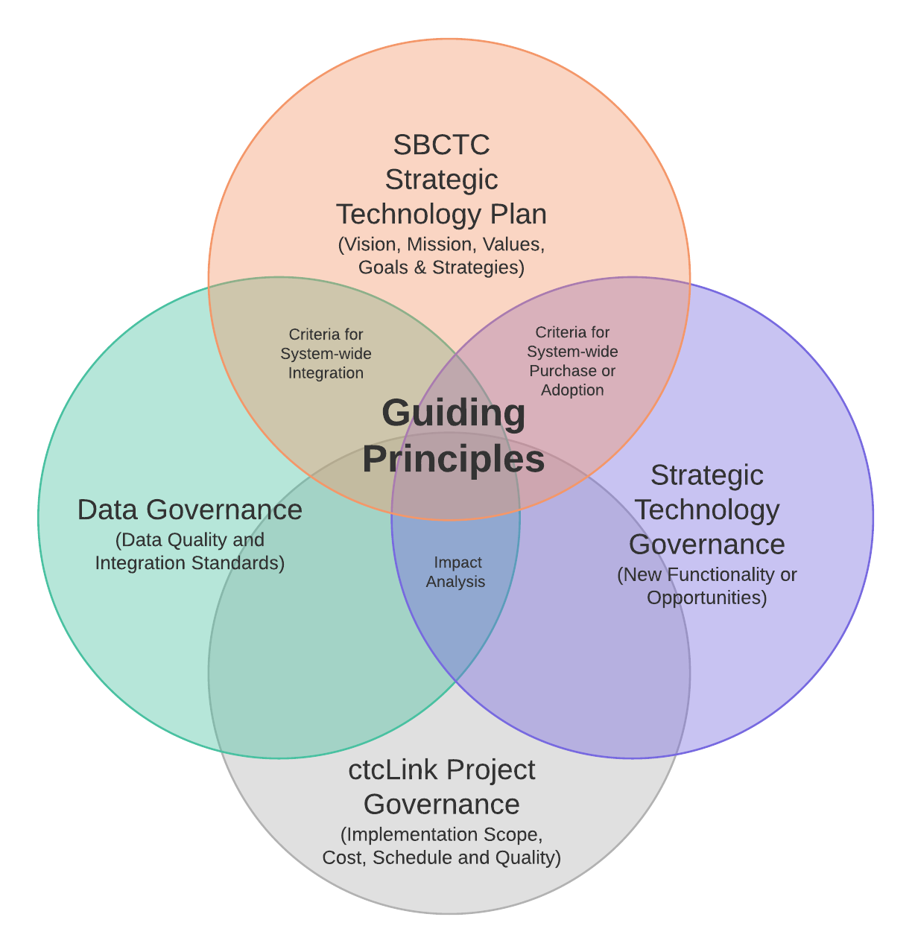
Current Priority Issues
In Scope or Out of Scope for STAC?
ctcLink Accessibility
CampusCE
Online Admissions Application
Guided Pathways Technologies
Notes:
Grant

Slide 4
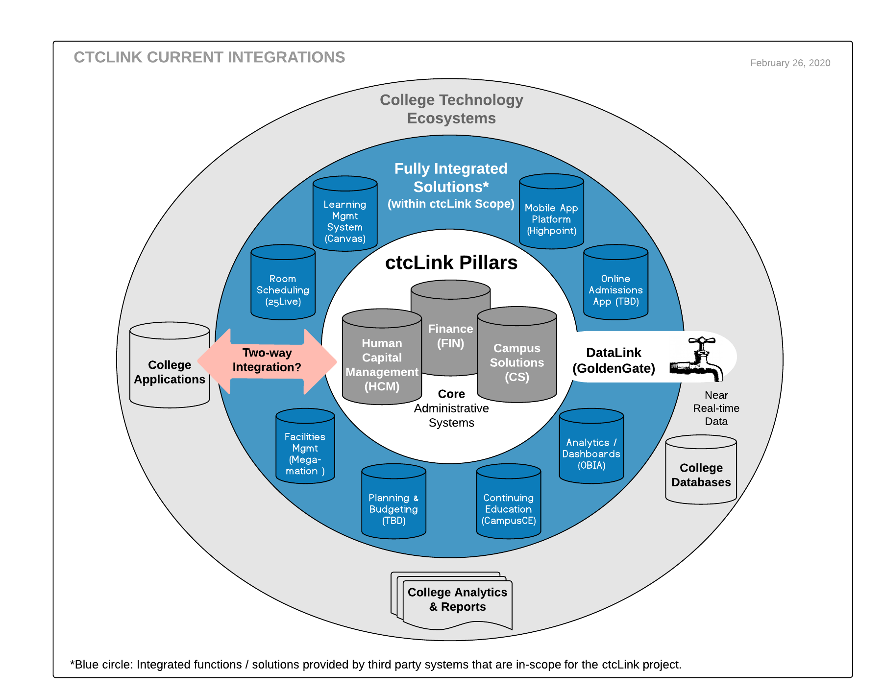
Framework for Recommendations
Leverage existing functionality before integration of third-party solutions
Minimize customizations to control ongoing support costs
Consider system-wide impacts and needs
*Are there viable alternatives to this recommendation or consequences of not doing it?
Is 2 way integration with ctcLink required? | Yes/No
Is the functionality within scope of ctcLink Project? | Yes/No
Will the functionality be used or potentially used by all WACTC colleges? | Yes/No
What is the impact to all colleges if we don’t do it?* | High/Low
Notes:
Eva

Slide 5
CampusCE Example
Background:
Part of remediation for ctcLink. Original solution wasn’t acceptable
RFP for new solution: CampusCE was chosen
Current status is: Implementation and Integration
Implementation costs are included in ctcLink Project
Issue: Is CampusCE an Enterprise Solution? How should support be funded?
Ongoing costs of maintenance and operations is substantial for the entire system. Pricing was built on a system-wide adoption.
What are the characteristics of Enterprise System funded solutions?
How does the system fund ongoing costs in a fair/equitable manner?
Is 2 way integration with ctcLink required? | Yes
Is the functionality within scope of ctcLink Project? | Yes
Will the functionality be used or potentially used by all WACTC colleges? | Yes
What is the impact if not implemented (or funded centrally)? | High
Notes:
Grant -Eva

Slide 6
ctcLink and Accessibility
Background -Discussion
One Pager - Plan of Action
Notes:
Grant

Slide 7
Lessons from COVID
How has the move to remote work/learning due to COVID-19 changed Higher Ed?
What do we want to keep doing? Best practices?
What are the considerations for future “strategic” technologies?
What has been resilient (adaptive) and what has been fragile during the COVID-19 crisis?
Are we using the “right” technologies? (Security considerations, accessibility, integration, etc.)
What specific technologies will/may be needed? Strategic recommendations at the system level?
Notes:
Eva & Grant

Slide 8
Other Areas of Focus
Issue Briefs - One Pagers
Issue / Opportunity Briefs
Scope of the Issue
Impact: Why is it important to the WACTC System (Colleges)?
Communications: Who needs to be involved? (Short RACI?)
Recommendations:
What Policies/Procedures are Needed?
What Technologies are needed?
Timeline
Conclusion - next actions, etc.
Standard Contract Processes
Accessibility - Formal Testing
Used or potentially used by all colleges?
Analysis of impacts - centralized vs. local costs?
Finalize Charter and Committee Work Processes
Notes:
Eva

