Slide 1
Adult Education Advisory Council
Winter 2023
February 21, 2023
8:30 a.m. – 1:30 p.m.
Virtual Meeting

Slide 2
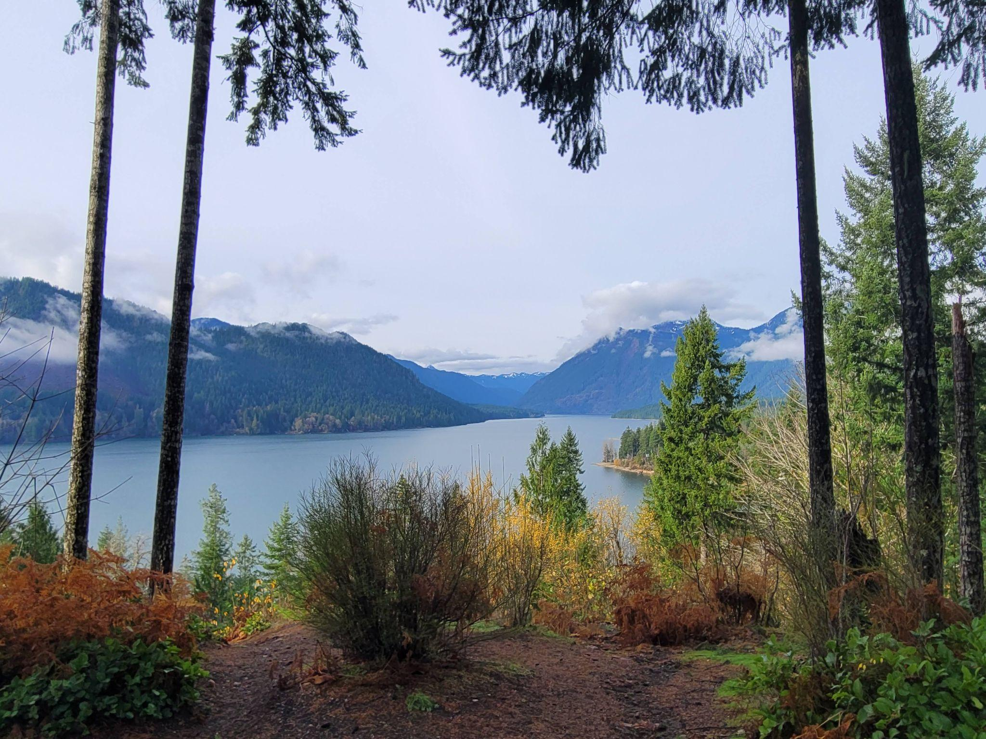
Welcome
Please type your name and organization into the chat.
We will start promptly at 8:03 AM
Take a moment to refresh coffee, water, hug a loved one, pet an animal
PNW; Lake Cushman; 2021
Traditional Land of the Skokomish People

Slide 3

A Minute to Arrive
Photo Credit: Pedro Ramos on Unsplash

Slide 4
AGENDA
8:03 am Call to Order
      Introductions of Council Members
8:30 am EDI Activity
      Black Bodies Acknowledgement
      Adult Education is Social Justice Activity
9:00 am Minute Approval
Agenda Review
Announcements
9:15 am Break
9:30 am SBCTC Update
      William Durden, Director of BEdA
      Troy Goracke, Policy Associate
10:00 am CBS Update
      Heidi Summers
10:10 am Council Members Advocacy Work Share-out/Updates
10:45 pm Break
11:00 am Committee Breakouts (Committee determines when to break)
12:00 pm Committee Debrief
1:00 pm Closing the Loop/Good for the Order
Meeting Schedule for 2022-23:
June 6-7, 2023 – In-person, Eastern WA

Slide 5
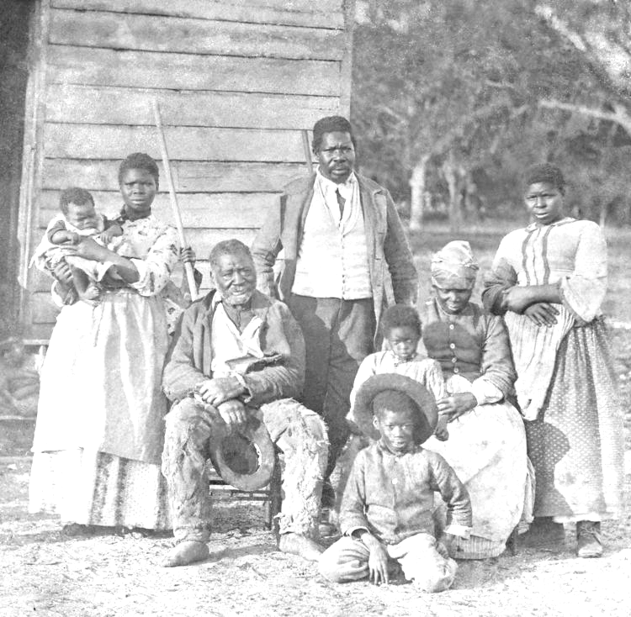
Black Bodies
Acknowledgement
Notes:
This work is a combination of materials and words pieced together by colleagues within the Washington Community and Technical College System:
Justin Dampeer, Highline College
James “JJ” Jackson, Evergreen State College
MarcusAntonio Gunn, Washington State Board for Community and Technical Colleges
-----------------------------------------------------------------------------------------------------------
Cotton produced by Unpaid Laborers was the raw material for the first world wide manufacturing system. Their labor and the wealth it produced is the reason the USA grew faster than England, France and all western economies.
Photo from: https://www.unpaidlabor.com/economy. Visit the site to get more information about how the unpaid labor of enslaved Black people built the economy of what we consider to be the United States.

Slide 6
Ancestors Acknowledgement
We must acknowledge that much of what we know of this country today, including its culture, economic growth, and development throughout history and across time, has been made possible by the labor of enslaved Africans and their ascendants who suffered the horror of the transatlantic trafficking of their people, chattel slavery, and Jim Crow. We are indebted to their labor and their sacrifice, and we must acknowledge the tremors of that violence throughout the generations and the resulting impact that can still be felt and witnessed today.”

Slide 7
Racial Justice Acknowledgement
And we want to acknowledge stolen lives – lives ended too soon by what Ruth Wilson Gilmore calls an unequal distribution of premature death. In particular we want to pay homage to George Floyd, Breonna Taylor, Ahmaud Arbery, and countless others who have lost their lives to the bigotry that leads to ongoing personal, mob, and state violence and we want to pay homage to every black man, woman and child whose life has been taken, who have died prematurely as a consequence of these structures. We hold a place for the countless often forgotten.
We call for the dismantling of systemic policies and practices that create barriers and disadvantages for black folks. We must believe that in order for all lives to truly matter, we must reckon with our nation’s disenfranchisement of the black life, the negro life, the africans who feet were the first to touch this continent’s soil.
We started to hear it said about five (5) years ago as part of the Movement for Black Lives, and we may need to remind ourselves for a little while yet: “when black lives matter, everybody lives matter.”
Ase` O (adpated from James “JJ” Jackson, Evergreen State College )

Slide 8
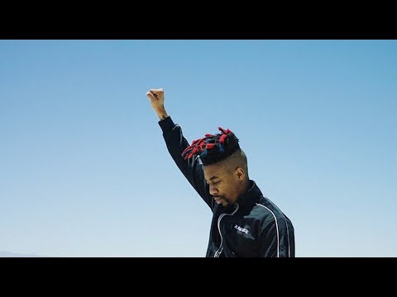
BLACK LIVES MATTER

Slide 9

Break
Notes:
3 minutes MarcusAntonio
Photo of a door opening into a beautiful garden by by Pedro Ramos on Unsplash
Gratefulness, as a mindfulness exercise

Slide 10
SBCTC Update
Winter 2023 Adult Education Advisory Council
Will Durden
State Director, Basic Education for Adults
State Board for Community and Technical Colleges

Slide 11
SBCTC-BEdA Updates
Federal Advocacy Work
Marketing Strategy towards Faculty Recruitment (Goal 1)
Digital Literacy/Digital Equity Project (Goal 2)

Slide 12
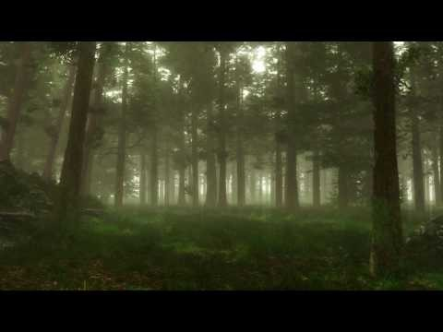
Break
Notes:
3 minutes MarcusAntonio
Photo of a door opening into a beautiful garden by by Pedro Ramos on Unsplash
Gratefulness, as a mindfulness exercise

